Slide 1
Extreme Java
Rony keren

Slide 2
Topics 1
JVM
Roles
Modes
Features
Memory types
Weak References
GC
Introduction
GC types
GC Algorithms
Heap generations
G1
Tuning
Class-Loading
Introduction
Endorsed, Ext and Classpath
Build-in mechanism
Custom class loading
Multithreaded CL
Java Mission Control (JMC)
Java Concurrency
Basics brief
Executors
Callable & Future
Atomic Concurrent
Lock API (Lock, Criteria)
Barriers
Fork-Join
Concurrent Collections

Slide 3
Topics 2
Reflection
The need
Loading classes
Exploring class constructors, methods and fields
Manipulate objects with reflection
Handling arrays
Handling annotations
Reflecting parameter names (Java8)

Slide 4
JVM Internals
Roles
Modes
Memory types
Weak references

Slide 5
Virtual Machine
VM Data areas:
Heap
for Objects and Arrays
shared by all VM threads
Stack
command and block sequence
recursive
Thread scoped – each thread has its own stack
Metaspace– Permanent
loaded classes
constant string pool

Slide 6
Virtual Machine
VM Data areas:
Java 6
Classes and interned strings were allocated in the PermGen which was part of the heap
Java 7
Puts interned strings in a new place – Metaspace
Java 8 doesn’t come with a PermGen at all. Only Metaspace.
Classes are also allocated on Metaspace
Metapsace
Native space used for holding classes and interned strings
Faster than PermGen
By default – has no max size –
Allocates memory according to needs (unlike PermGen which was part of the heap)
Native memory reduces footprint and executes faster

Slide 7
Virtual Machine
Byte code execution
JDK 1.0 - Direct interpretation
Simple VM implementation – small footprint
Problem: Slow. No-cache
JDK 1.2 – JIT
Caching of byte code for re-use
Problem: most optimizations are for client side code
JDK 1.3-4 – Hotspot
Tracks hotspots for both server & client applications
VM uses a global information for optimization (like peek blocks/flows)
Problem: Heavy VM, big footprint

Slide 8
Virtual Machine
Byte code execution
JDK 5.0 - Byte-code cache and share
JDK 6.0 - API for for scripting engines
JDK 7.0 – Dynamic invocation for scripts
JDK 8.0 – LAMBDA exp. Support
Smaller JVM footprint – heading toward embedded Java
Streaming API – getting ready for clouds and big-data

Slide 9
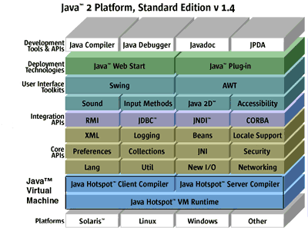
Hotspot
Enhanced JVM

Slide 10
Hotspot
JVM Modes:
Client mode – compiles instant used code - java –client …
Assuming that code will be reused frequently
Compilation starts sooner than in server mode
Fast launching – available JIT compilations for immediate execution
Server mode – compiles after more runtime analysis - java –server …
Assuming there is much going on so better sit and analyze…
Optimizations are much more sophisticated
Slow launching – analyzing….. Code is re-interpreted until JIT kicks in…
Tiered compilation
Java 7 – experimental
Java 8 - default

Slide 11
Hotspot
JVM Modes:
Client mode defaults
JIT compilation after 1500 invocations
Server mode defaults
JIT compilation after 10000 invocations
Manually set via : -XX:CompileThreshold=<int value>

Slide 12
Hotspot
JVM Modes:
Java 8 - Tiered Compilation by default
Starts in client mode for fast launching and then shifts into server mode
Was experimental in Java 7 (XX:+TieredCompilation)
Default in Java 8 (for –server supported environments)
Code fragments are being discarded of refactored along the way

Slide 13
Virtual Machine
Memory management
Allocate memory from OS
Manage Java allocations
Clean memory from garbage
Garbage
Objects that cannot be reclaimed anymore - unreachable
Object that are no longer referenced (explicitly & implicitly)
Object that are freed via programmatic directives

Slide 14
Virtual Machine
Memory management
Reachable objects
VM manages a Root Set
Consist of :
Static references
Local references
Is the first level of referenced objects
Other objects might be referenced by root set objects
Garbage collection
starts in iterating root set objects
Then visiting indirectly referenced objects that in its scope

Slide 15
Virtual Machine
Memory management
Heap
Root Set

Slide 16
Hotspot
Improves caching of objects & methods
Fast and fully accurate garbage collection
Offers more GC algorithms
Code refactoring
Method in-lining
Loop unrolling (increasing loop body to reduce iterations)
Flow rearranging (fitting compiler instructions order to the machine)

Slide 17
Hotspot
Class Data Sharing
Share class data between different JVM processes of the same build
supported from JDK 5
Reduce the startup time
Reduce memory footprint
On loading time some system classes metadata is stored in “shared archive” file
Data is loaded into memory at runtime according to the application needs
java –Xshare:dump - regenerate file
java –Xshare:off - disable sharing
java –Xshare:on - enable sharing
java –Xshare:auto - default, enable when possible

Slide 18
Hotspot
Smart thread queue management
Hard worker threads will get much more CPU time
Faster thread synchronization
Statistics between program executions to improve performance
Reflection & Serialization improvements
Advanced logging when handling native crashes specifying:
function name
library name
source-file name
line number where the error occurred

Slide 19
Hotspot
Monolithic heap
single heap
easy to tune
not much to manage & therefore consume less memory
Generational heap
separates the heap area into New objects region & Old object region
survivor spaces are sub-regions of New
each region is tuned and managed separately
Generational Heap
new
OLD
new
EDEN
SURVIVOR
SPACE 1
SURVIVOR
SPACE 2
dead

Slide 20
Escape Analysis
Escaped references
When a stack creates an object and hands it to an outside caller
Non-escaped references
When a stack is the only one uses an object
When a caller assigns an object to a stack and get rid of his reference
public Object method (){
Object o = new Object();
otherMethod(o) // Object escaped…
}
public Object method (){
Object o = new Object();
…
}

Slide 21
Escape Analysis
What is ‘escape analysis’ ?
Tracking non-escape references
Turning the non-escape object state to be part of the stack that uses it instead of being allocated on the heap
JVM tracks non-escape references
And turns the object state to be
part of the stack that uses it
public Object method (){
Pixel p = new Pixel(100,30);
…
}
public Object method (){
int x=100;
int y=30;
…
}

Slide 22
Escape Analysis
Done during interpretation phase
Supported in Java SE 6 u23
To activate use:
XX: +DoEscapeAnalysis

Slide 23
Compressed Pointers
JDK 7.0 improvement
For reducing JVM process footprint
Compressed 64-bit ordinary object pointers (oops)
Java uses 32 bit offsets + 32 bit for a specific address
Offsets are the prefixes of the whole virtual address
Instead of : we get:
AB27D
147C3
147C3
AB27D
26AB2
26AB2
AB27D
D62A1
AB27D
D62A1
AB27D
A432B
A432B

Slide 24
Smaller Footprint
Java 8 smaller VM
Up to Java 7 footprints averages are
6Mb for –client
9Mb for –server
In Java 8 JVM shouldn’t use more than 3Mb on startup
Smaller plugins are better for small clients….
How what it achieved?
By getting rid of large components from Java Kernel
Kernel makefiles now differentiate between required and optional components

Slide 26
GC
Introduction
GC types
GC Algorithms
Heap generations
G1
Tuning

Slide 27
Garbage Collector
Responsible for cleaning Objects from the Heap
Is a low priority daemon thread that runs aside the main program
Unreachable objects are destroyed [finalize() is called]
Can be invoked by the programmer [System.gc();] – not recommended
Helps in keeping development easy and comfortable
Object obj=new Object();
obj=null;
Garbage Collector
Stack
Heap
obj
null
Object instance

Slide 28
Garbage Collector
finalize() method
Is called by the GC before removing an object from the heap
Calling it programmatically will not result in the object destruction – not a destructor !
Do not count on it to perform business logic unless you know what you are doing
Since GC is a daemon thread – if main thread dead - GC might not make the call
Exception thrown are ignored by the CG
gc() method
Do not count on it to “stop the world” - it doesn’t
GC gets a higher priority and a better chance to be the next one to get CPU time
Useful for forcing heap cleanup when there’s a memory leak when debugging
Log GC to a file
Run application with –Xloggc:<file>

Slide 29
Garbage Collector
Roles:
Mark the object for deletion when applicable
Remove the object form memory
All GCs marks objects
GCs algorithms specifies the way they are removed
Triggered by:
VM allocation failure (that suspends the current thread for the GC)
System.gc()

Slide 30
Garbage Collector
Monitoring GC
java –verbosegc MyProgram
Amount of freed Kb
Amount of occupied Kb
Heap current size
Time consumed by GC

Slide 31
Garbage Collector
GC Strategies:
Sweeping GC
Compacting GC
Copying GC

Slide 32
Garbage Collector
Sweeping GC
Scans the heap and simply removes all marked objects
Quick since no further management takes place
Leads to free memory fragments making new allocation to become inefficient
Used Object
Marked object
Free space

Slide 33
Garbage Collector
Compacting GC
Scans the heap and removes all marked objects
Moves used objects to freed memory area to prevent memory fragments
Needs to check if any moved object matched the free space fragment
Therefore slower
Used Object
Marked object
Free space

Slide 34
Garbage Collector
Copying GC
Copies used objects to inactive regions
Less need in matching object to available space
Faster than Compacting CG
Requires greater heap in order to manage inactive regions
Used Object
Inactive Region
Marked object
Free space

Slide 35
Garbage Collector
GC Types:
Simple
blocks all threads while cleaning – “stop the world GC”
More heap allocations for objects causes longer pause time
Concurrent
allows other threads to run along the GC threads
each GC thread is responsible for one region in the heap [concurrent marking]
available only for –server VM instances
use –Xcongc to enable

Slide 36
Garbage Collector
GC Types (cont’):
Parallel
distribute the GC work to multiple processors
one thread coordinates a specified number of helper threads
available only for –server VM instances
one thread per processor - done via –Xgcthreads[n]
Incremental
relevant for Old generation
breaks the region into smaller chunks
cleans each region individually
breaks overall pause time into many short pauses but overall throughput increases
use -Xincgc

Slide 37
Generational GC
Heap generations – New
Minor GC – Copying GC
EDEN & 2 survivor spaces
intensive allocations
intensive GC activity
Inefficient memory usage
When EDEN is about to overflow – copying collection takes place:
Most of its objects are unreferenced
Those who are referenced are copied to the survivor space 1 inactive region
Next time – objects are copied from both EDEN & SP1 to the SP2
SP1 is now clean again – so the phases can repeat until –
Long lived object eventually moved to OLD region

Slide 38
Generational GC
Heap generations - Old
Less allocations
Less GC iterations
Efficient memory usage
OLD region may use several GC strategies
Sweep / compact
Incremental GC
Concurrent GC
Parallel GC
There is no dedicated GC for Old region
Full GC (collects on New, Old & Perm)

Slide 39
G1
G1 (Garbage First)
A long run replacement for CMS (Concurrent Mark Sweep GC)
Available in Java 6 update 14

Slide 40
G1
More on G1
Instead of sweeping – compacts and defragments
Also generational (acts on OLD region)
Based on concurrent / parallel behavior
Like CMS, a low-pause GC
Usage: --XX: +UseG1GC
In Java 6 activate feature first with: -XX:+UnlockExperimentalVMOptions

Slide 41
G1
G1 – How does it work ?
Compaction occurs first on regions where most reclaimable
objects exist
Compaction means:
remove all phantom objects from memory
Merge referenced objects locations with others to create large ‘clean area’ in the heap
When JVM needs new space for a new object – is seeks the largest clear area
More efficient footprint management, more efficient allocations
Good only for OLD region
G1 seeks for areas where most phantom object exists
Therefore, compaction will be highly effective (not much left…)

Slide 42
Garbage Collector
Loitering objects
Are unused referenced objects
Cannot be garbage collected
How do we get to this situation ?
Mainly by
Business flow / use-case / method allocate resources in order to implement some business
Operation flow ends successfully but –
Resources are not entirely removed
But also by
Returning a newly created object to a non efficient caller
Poor variable scope definitions

Slide 43
Garbage Collector
Loitering objects
Allocated
Handled by GC
Reachable
“Loiterer”
Live

Slide 44
Garbage Collector
Loitering objects
Identifying loitering objects
Identify problematic use cases
Use monitoring & debugging tools to track allocation done in the use case implementation
Measure the state before entering the use case flow
Look the differences after it ends
Are those the new objects you expected
Are any unnecessary objects are still referenced
Fixing loitering objects
Track down loitered objects
Track the objects that allocated them
Determine and implement the points of making them unreachable

Slide 45
Tuning
Default GC settings:
Generational heap
2 survivor spaces
Young region uses copying collector [parallel is also supported]
Old region uses compact collector [can use sweep collector instead]
Some GC tuning & setting properties:
Field | Description
-XXNewSize / -XXMaxNewSize | sets the size and max size for EDEN & SP1,2
-XXUseParallelGC | sets the GC to be parallel
–Xgcthreads[n] | sets the number of helper threads to use in parallel GC
-XX:+UseConcMarkSweepGC | turns on concurrent GC in OLD region
-XX:TargetSurvivorRatio=z | sets the number in % of SP that must be occupied so objects will turn old
-Xincgc | Enables incremental GC
-XX:MaxTenuringThreshold=x | Sets the number times a new objects can move from SP1 to SP2 before turning old (tenured object) default 15
-XX:GCTimeLimit=time-limit | the maximum time spent by the GC (% of the total time) - default 98%
-XX:GCHeapFreeLimit | the minimum amount of freed heap per GC iteration (% of heap size) – default 2%
-XX:NewRatio | Specifies the ratio of NEW & OLD regions [example: 6 means 1/7(NEW):6/7[OLD)] – defaults: server-2, client 8
-XX:SurviverRatio | Specifies the ratio of EDEN and the two survivor spaces [example: 6 means 6/8(EDEN):1/8(SP1):1/8(sp2)] – default 25

Slide 46
Tuning
Setting permanent memory attributes
Major GC includes both permanent and heap memory
Minor GC is scoped to a generation
Field | Description
-Xnoclassgc | Disables class GC in permanent memory (!)
-XX:PermSize | Sets the initial size of permanent memory
-XX:MaxPermSize | Sets the maximum size of permanent memory

Slide 47
Tuning
Setting Java 8 Metaspace memory attributes
From now on:
Native memory is allocated as needed
OutOfMemoryError: Metaspace Error
Use –verbosegc to view Metaspace GC activity
Field | Description
-MaxMetaspaceSize | Sets the maximum size of metaspace memory

Slide 48
Weak References
Basic terms
Strong reference
Regular references
GC may remove objects that have no strong references
Weak reference
Special references that are used to reference objects
GC may remove objects when all references to that object are weak

Slide 49
Weak References
The need
When storing data in Collections , for example
The collection holds references even when data is no longer required
Removing data from the collection might effect clients
When caching heavy-weight objects
Once again – that caching might prevent data from being GC’ed
That cache mechanism must be maintained
Java is capable of managing garbage but:
In those cases, when strong references are used, GC is irrelevant
We will be flooded with loitered objects & memory leaks

Slide 50
Weak References
The solution
Give clients strong references
Manage resource collection & cache via weak references
Java provides 4 strength levels for referencing
Strong reference
Soft reference
Weak reference
Phantom reference

Slide 51
Weak References
java.lang.ref.Reference
Is the super class for all reference types
Has 3 subclasses for each weak reference level
Each subclass effect the way CG treats objects
Each subclass may be extended for more functionality
Has the following operations:
clear – clears the object held in the Reference object
get – returns a strong reference to the object held in the Reference
enqueue – adds the Reference to a Reference Queue (if registered to any)

Slide 52
Weak References
Reference Queue
Queue that holds references to null
Reference that is no longer points to an object is added to that queue
Reference must register itself to a queue in order to gain this service
Is an automatic mechanism
Registering a reference to a queue is done via Reference constructor
References can be consumed via 3 of the queue methods
Poll – returns the last added reference or null if empty
Remove – returns the last added reference or blocks until one becomes available
Remove (timeout) – same as previous but might return null when timed out

Slide 53
Weak References
Soft reference
Objects with soft references will be lazily garbage collected
Means that the system will let them survive GC even with no strong references
System cleans them when any memory limitation occurs
Great for cache auto-management
Clients uses strong references to heavy weight objects
Cache services uses soft references
When clients release their strong references – cached data is not GC’ed
JVM requirement for more memory may lead to cached object removal
Timing is determined according to client use & system resources automatically !
Use java.lang.ref.SoftReference

Slide 54
Weak References
Soft reference - example
import java.lang.ref.SoftReference;
public class SoftExample {
public static void main(String[] args) {
Object obj=new Object();
SoftReference<Object> soft = new SoftReference<Object>(obj);
obj=null;
System.gc();
try{Thread.yield();}catch(Exception e){}
System.out.println(soft.get());
}
}
Client gets strong reference - word
Cache mechanism gets soft reference
Client release reference when no longer needed
Cache keeps on referencing even between GC calls
Other clients may ask for strong references via soft.get() method
Output:
java.lang.Object@7d772e
Notes:
The following explanatin applies to the line marked in bold in the slide:
Here the thread is only in Created state, but it is not Running yet, and event not in Runnable state!

Slide 55
Weak References
Weak reference
Objects with weak references will be eagerly garbage collected
Means that they will be removed on the first GC iteration
Will stay alive if strong and soft references still exist
Great for cache resource collections
Clients uses strong references to resource objects
Containers may collect those objects via weak references for:
Monitoring & logging
Managing
Attach more information and data to each resource while alive
When clients release their strong references – resources are GC’ed
Container enjoys immediate removal of resources automatically !
Use java.lang.ref.WeakReference

Slide 56
Weak References
Weak reference - example
Client gets strong reference - word
import java.lang.ref.SoftReference;
public class SoftExample {
public static void main(String[] args) {
Object obj=new Object();
WeakReference<Object> weak = new WeakReference<Object>(obj);
obj=null;
System.gc();
try{Thread.yield();}catch(Exception e){}
System.out.println(weak.get());
}
}
Cache mechanism gets weak reference
Client release reference when no longer needed
Containers get rid from weak refs when no strong reference exist
Other clients may ask for strong references via soft.get() method
If objects still alive – a strong reference is returned
If objects were garbaged – a null value is returned
Output:
null
Notes:
The following explanatin applies to the line marked in bold in the slide:
Here the thread is only in Created state, but it is not Running yet, and event not in Runnable state!

Slide 57
Weak References
Phantom reference
Objects becomes phantom referenced when
No strong or soft references exist &
The object was finalized &
Only phantom references exists, or none
Main usage is to add functionality to the origin object finalize() method
Offers more flexible mechanism – event queue
Phantom referenced objects are already finalized & cannot reproduce strong references (unlike soft & weak references)
Therefore get() method always returns null
Use java.lang.ref.PhantomReference

Slide 58
Weak References
Phantom reference - example
import java.lang.ref.*;
import java.util.Date;
public class PhantomExample {
public static void main(String[] args) {
Object obj=new Object();
ReferenceQueue<Object> queue = new ReferenceQueue<Object>();
PhantomReference<Object> phantom = new PhantomReference<Object>(obj,queue);
obj=null;
System.gc();
try{Thread.yield();}catch(Exception e){}
try {
queue.remove();
// Now the object was finalized for sure
} catch (InterruptedException e) {}
}
}
Creating phantom
reference & register
in queue
Client release ref
when no longer
needed
Reference is added
to the queue after obj
is finalized but before
its memory reclaimed
Output:
Tue Jan 22 13:54:11 GMT 2008
Remove operation
blocks until a ref is
available in the
queue
Notes:
The following explanatin applies to the line marked in bold in the slide:
Here the thread is only in Created state, but it is not Running yet, and event not in Runnable state!

Slide 60
Class Loading
Introduction
Endorsed, Ext and Classpath
Build-in mechanism
Custom class loading
Multithreaded CL

Slide 61
Class Loading
Instances of class java.lang.Class represent classes and interfaces in a running Java application
Class has no public constructors
Any applications cannot instantiate it
Class is automatically instantiated by JVM/class loader, when a class loading process is done
Each instance of Class keeps a reference to a class loader that created it

Slide 62
Class Loading
When you instantiate a new object new Foo() class loader performs the following major steps:
Loading – loading class byte data from a file or other
Linking – preparing the binary data to be used in Java runtime
Initializing – loading and populating class variables and blocks
If those 3 steps performed successfully – Foo instance can be created & returned
Else – exceptions are thrown (later)
Class loading

Slide 63
Class Loading
Class loading process:
Loading
Linking
Verification
Preparation
Resolving
(optional)
Initializing

Slide 64
Class Loading
Loading and linking phases are flexible on their time of execution
Initializing, on the other hand, may occur only in these active uses:
When creating new instance for the first time
Invocation of a static method on a class
The use of a static field in a class
The usage of reflection upon a class (using Method required its Class..)
The initialization of a subclass of a class
On launch – loading the class with main() method

Slide 65
Class Loading
Classes vs. Interfaces
When classes are loaded -
All its super-classes must be loaded too
Interfaces are not loaded
When interfaces are loaded -
None of its super-interfaces is loaded
What triggers Interface loading for a class ? - A polymorphic usage of it !
public class Airplane extends Vehicle
implements Flyable {
…
}
…
Airplane plane = new Airplane();
plane . drive ();
plane . accelerate ();
((Flyable) plane ) . fly();
…
Here both Vehicle and Airplane
classes are loaded
This line triggers Flyable class
loading

Slide 66
Class Loading
Loading phase
in order to load a class JVM must:
take a fully qualified class name
parse the class byte stream into the method area*
stream can be taken from anywhere (FS, ZIP, DB, Network, Runtime…)
create an instance of java.lang.Class for the type
*VM Method Area
A storage area for class information and structure
Class data is constants, variables, method and constructor code
Created on VM startup
This area is sharable among different VM instances (since JDK5 &if share enabled)
When full – OutOfMemoryError is thrown

Slide 67
Class Loading
Linking phase – Verification
Scan for defects like invalid operation code and invalid signatures
This phase ensures that:
the type obeys the semantics of the Java language
VerifyError is thrown at these phase if class is given in a wrong format
it won't violate the integrity of the virtual machine
LinkageError is thrown when dependant classes were incompatibly changed
Has specific sub-errors like AbstractMethodError if there is a call to an abstract method in a class

Slide 68
Class Loading
Linking phase – Preparation
Allocation for java.lang.Class instance
During this phase the class variables are allocated
They are populated with default values just like any other object
Initiation values are not applied yet
More custom adjustments can also be used
like method table – table that holds pointers to the data for each method (including data from superclasses)

Slide 69
Class Loading
Linking phase – Resolution
Locate fields, methods, classes and interfaces symbolically referenced from the class runtime constant pool*
Optional – if all or some are already located by previous class loadings – no need to do it again..
*Runtime constant pool
A per type symbol table
Uses tags bounded with values [class=7, Fieldref=9, Methodref=10, String=8, Integer = 3, …]
Created symbolically on loading phase
Name of each tag can be seen with the Class.getName() method:
String → java.lang.String
MyClass → com.my.custom.MyClass
int [] → [I
int [][] → [[I
String [] → [Ljava.lang.String

Slide 70
Class Loading
Initialization phase
Applying all programmers static setup
overriding default values with programmer values
executing static blocks keeping the order it appears in the class
Actually, all static initializations and static blocks are gathered into a special method.
called ‘initialization method’ or ‘the () method’
public class StaticInitializationExample {
private static double x = Math.random();
…
public class StaticBlockExample {
private static double x;
static{
x = Math.random();
}
…

Slide 71
Class Loading
VM Default class loaders
Are created automatically on VM startup
Bootstrap class loader
Loads the standard libraries
Classes located at %JAVA_HOME%/jre/lib/
Also loads %JAVA_HOME%/jre/lib/rt.jar
From Java 6 – first loads jars placed in the lib/endorsed directory (allows to override Suns impl.)
Extension class loader
Default implementation Loads the set of extension libraries
Classes located at %JAVA_HOME%/jre/lib/ext/
Can be implemented in vendor specific way
System class loader
Loads user defined classes
Classes configured and mapped at VM %CLASSPATH% (both directories of classes & jars)
If class is not found – throws ClassDefNotFoundException

Slide 72
Class Loading
Custom class loaders
Are user implementation of class loading
Are created programmatically after VM startup
Implicit or explicit child of the System class loader
Are forbidden in Applets (too powerful)
Why use custom class loaders?
For customized class loading policy (like DB or Network class loaders)
Security and versioning filtering
Byte code formatting / adjusting
Deploying new modules while previous are still loaded

Slide 73
Class Loading
Endorsed directory
Place mature jars to override immature/buggy implementations in JDK core
List of API s that currently can be overridden:
Java API for XML Processing (JAXP) 1.4.5
Java Architecture for XML Binding (JAXB) 2.2.4-1
Java Compiler API 1.0
Pluggable Annotation Processing API 1.7
Common Annotations for the Java Platform 1.1
Scripting for the Java Platform 1.0
SOAP with Attachments API for Java (SAAJ) (package javax.xml.soap) 1.3.9

Slide 74
Class Loading
Class loader hierarchy
Bootstrap Class Loader
Extension Class Loader
System Class Loader
User-Defined Class Loader
User-Defined Class Loader
User-Defined Class Loader

Slide 75
Class Loading
Working with custom class loaders
Coding rules
Must extend system class loader (java.lang.ClassLoader) or other custom class loader
Must override Class findClass (String name) method
Defines the main logic of how and where the binary data is taken
Use super.defineClass(..) in order to reflect the loaded byte array into a Class [may also be overridden]
Using it
Create an instance of the custom class loader
Use loadClass (String className, boolean resolve) method to load a class reflection [Class]
Call Class.newInstance() method in order to create an object from the loaded class
Relevant for classes with empty constructor – otherwise use reflection to call the constructor with appropriate parameters
Causes static block execution, default values assignment & constructor execution

Slide 76
Class Loading
Working with custom class loaders
Example:
public class CustomClassLoader extends ClassLoader {
public Class findClass (String className){
byte[] data=null;
//fetch class and load into the byte array
//(or load class directly in Class format)
return defineClass(className,data,0,data.length);
}
}
public class Test {
public static void main(String[] args) {
CustomClassLoader loader=new CustomClassLoader();
try {
Object obj=loader.loadClass("Foo").newInstance();
} catch (Exception e) { e.printStackTrace(); }
}
}

Slide 77
Class Loading
Replacing default System class loader
Create a custom class loader
Don’t place class in your classpath... (use ext)
Set System property with fully qualified name of your class loader
Property name: “java.system.class.loader”
Property value:”fully.qualified.custom.MyClassLoader”
If this property is not set – default System CL is used

Slide 78
Class Loading Deadlock
Multithreaded class loading CL
How CL usually works?
Each CL has a parent (except Bootstrap CL)
When a class is required, the CL first check on its parent
If not loaded yet, CL asks its parent to load it
If cant be loaded from parent – loaded by CL
Note ! Loading classes operation is synchronized

Slide 79
Class Loading Deadlock
Multithreaded class loading CL
The problem:
In this scenario
D extends C and B extends A
CL1 loads A and D directly.
CL2 loads B & C directly.
A deadlock situation:
Thread1 wants B from CL2
Thread2 wants D from CL1
Thread 1
CL1
A,D
CL2
B,C
Thread 2

Slide 80
Class Loading Deadlock
2 different threads
2 different class classes with no direct relations
2 separate CLs
Why do we get deadlock ?!
Thread1 wants B from CL2
It locks CL2 to load B directly – but then –
CL2 locks CL1 in order to define B (so CL1 loads A)
Thread2 wants D from CL1
It locks CL1 to load D directly – but then –
CL1 locks CL2 in order to define D (so CL2 loads C)

Slide 81
Class Loading Deadlock - Fixed
Multithreaded class loading CL – fixed in JDK 7
Synchronization is no longer done according to CL
It is applied to the combination of CL + class name
Back to our scenario:
Thread1 will lock CL1 to load parent class A (lock CL1+”A”)
Then will lock CL2 to load B (lock CL2+”B”)
Thread2 will lock CL2 to load parent class C (lock CL2+”C”)
Then will lock CL1 to load D (lock CL1+”D”)
Problem solved – we have 4 different locks instead of 2…

Slide 82
Class Loading Deadlock - Fixed
Multithreaded class loading CL
How to use it ?
Basically this feature is turned off for backward compatibility
To turn on – call this method on your custom CL:
registerAsParallelCapable()
If the custom CL overrides findClass(…), then no further changes are needed
If the custom CL overrides loadClass(…)
Method defineClass() must be invoked ONCE for any CL & class name pairs
Define class obtains a lock on the parent CL to fully load class structure

Slide 83
Jconsole
A new tool provided as part of the JDK
Provides out-of-the-box monitoring and management support
Support both remote and local working modes
Is JMX based
Provided functionalities:
Detect low memory
Enable / Disable GC & class loading verbose tracing
Detect deadlocks
Control log level [where logger is in use]
View application’s MBeans
JVM
Java Applcation
Platform
MBean Server
Jconsole

Slide 84
Jconsole
Starting the console
Locally:
Start your application with the system property –Dcom.sun.management.jmxremote
This will activate the Mbean server
simply run ‘jconsole’ from the JDK bin directory
Choose your application to monitor from list
Remotely:
Start your application with the same property as in local mode
Set port via –Dcom.sun.management.jmxremote.port=portNum
Password can be defined, loaded from file and disabled via additional properties
Run jconsole host:port and choose your application from list

Slide 85
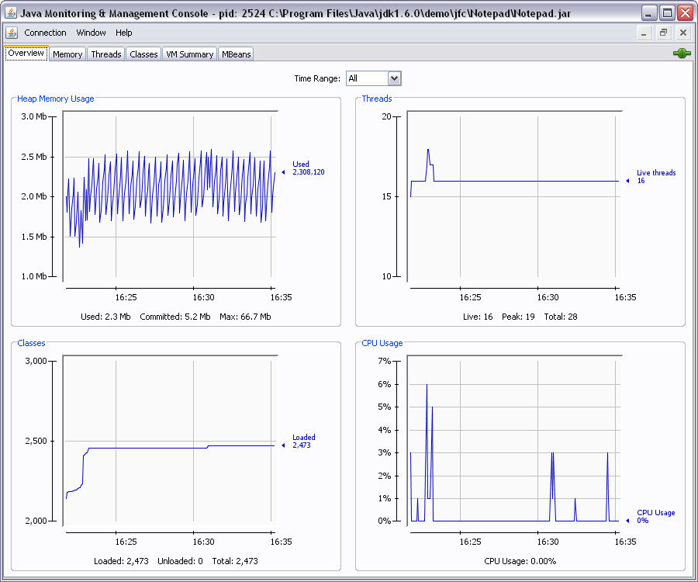
Jconsole

Slide 86
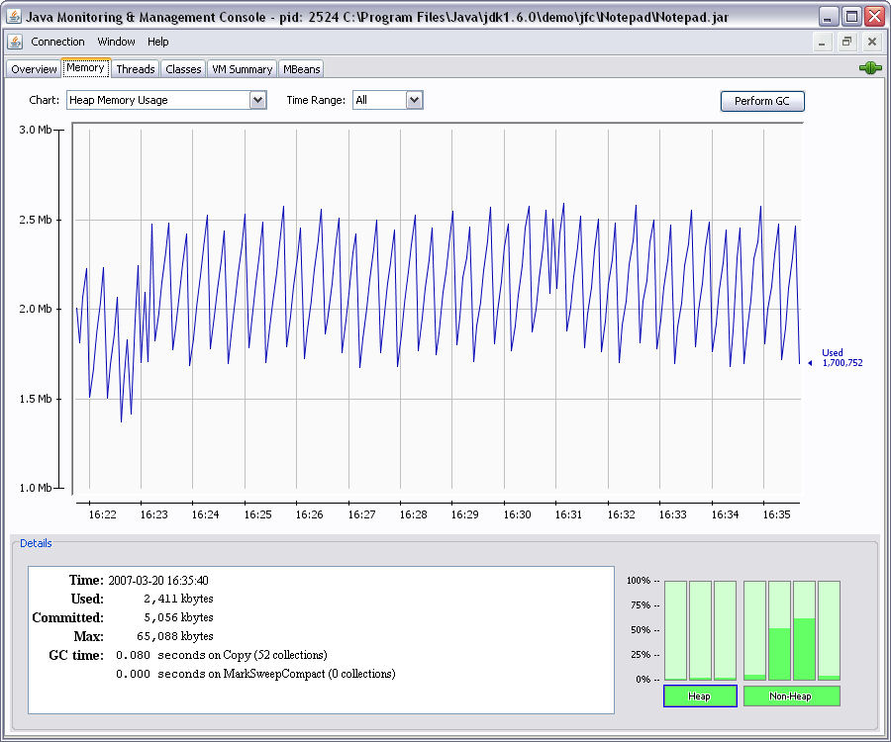
Jconsole

Slide 87
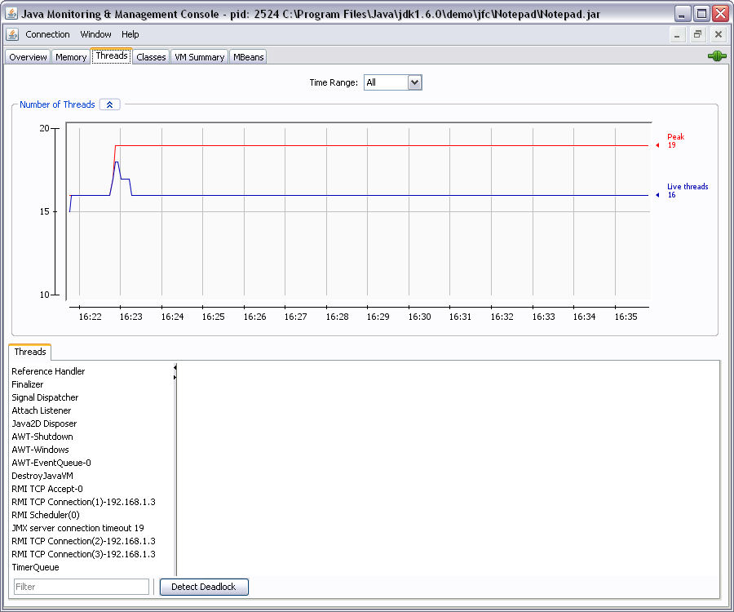
Jconsole

Slide 88
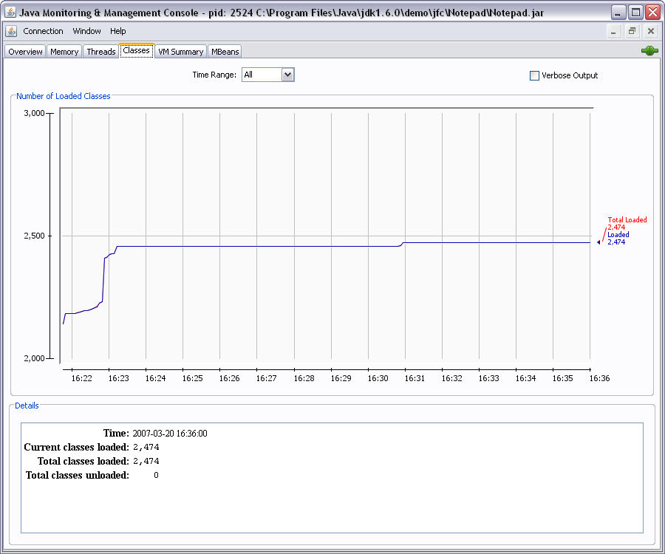
Jconsole

Slide 89
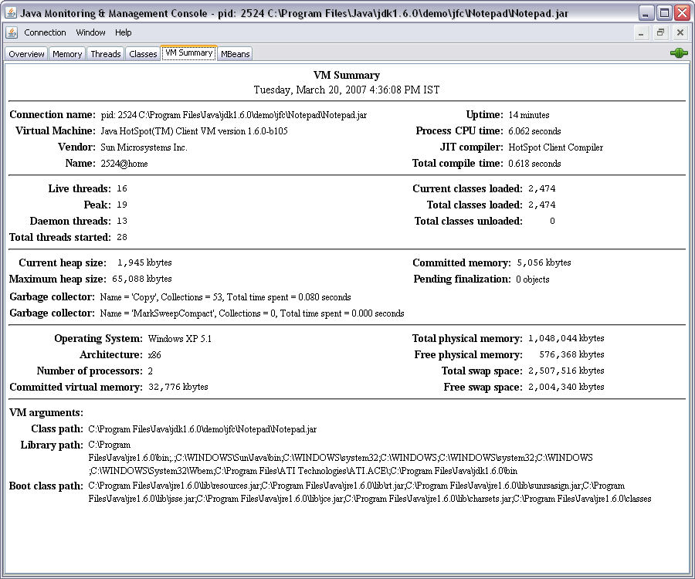
Jconsole

Slide 90
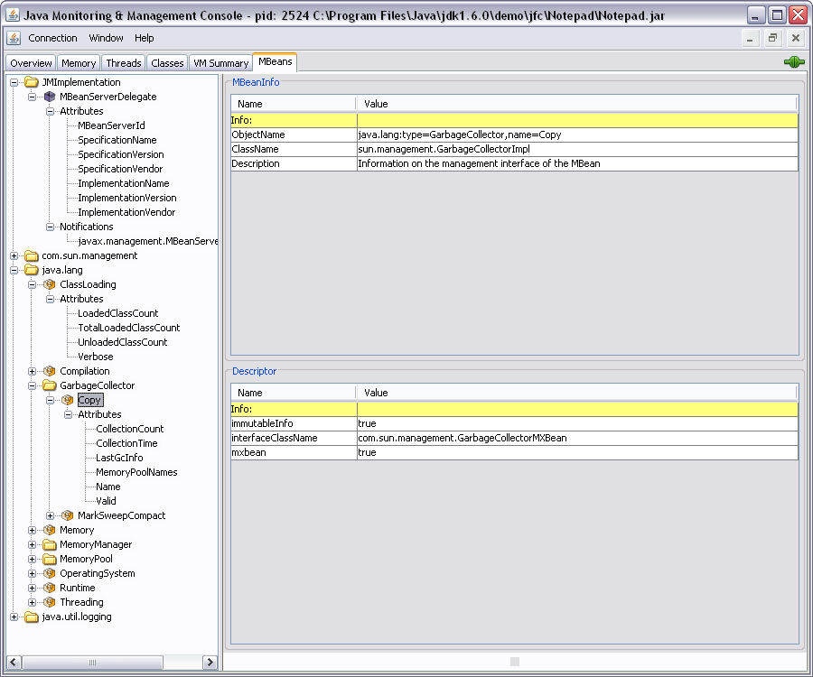
Jconsole

Slide 91

JMC
Java Mission Control
Available in the Oracle JDK since Java 7u40
Originates from JRockit JVM
Used for 2 main purposes:
Monitoring the state of multiple running Oracle JVMs
Java Flight Recorder dump file analysis
Built on JVM JMX Server
JAVA_HOME\bin\jmc.exe

Slide 92
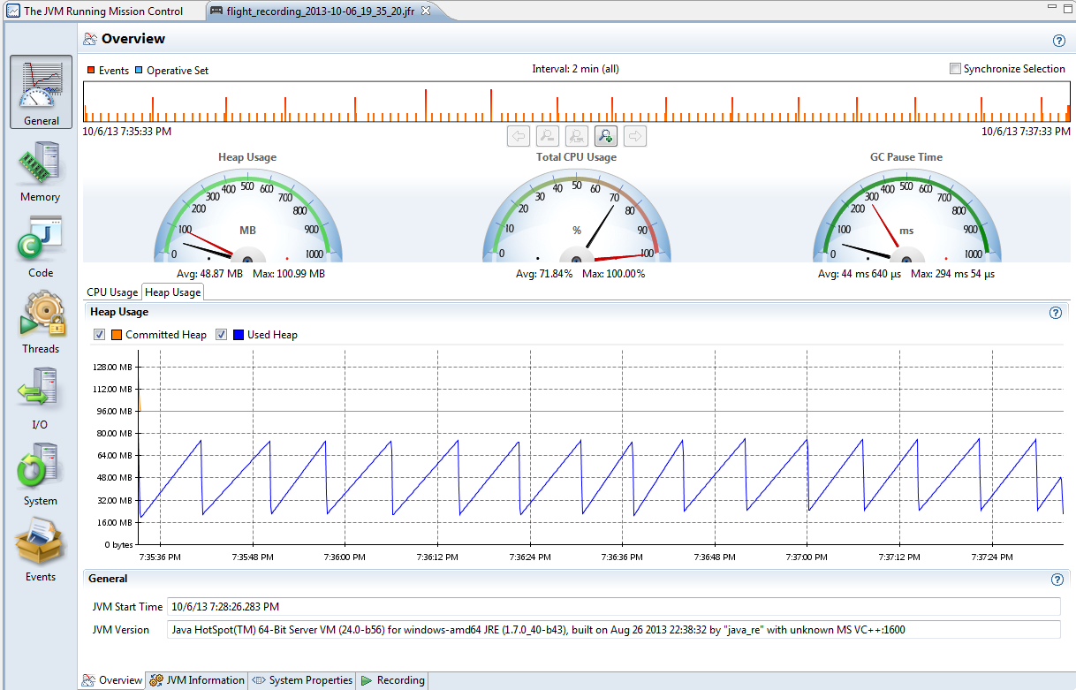
JMC
Java Mission Control
Real time processing
Heap
CPU
GC Pause time

Slide 93
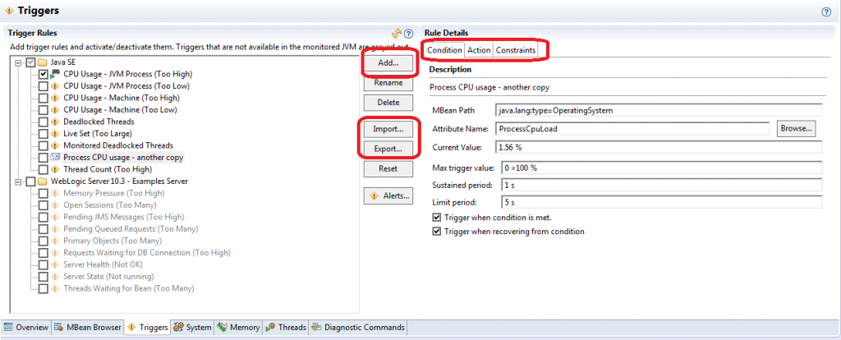
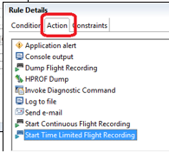
JMC
Java Mission Control
Event triggers
Act when JMX counter exceeds any pre-set limit in any given time

Slide 94
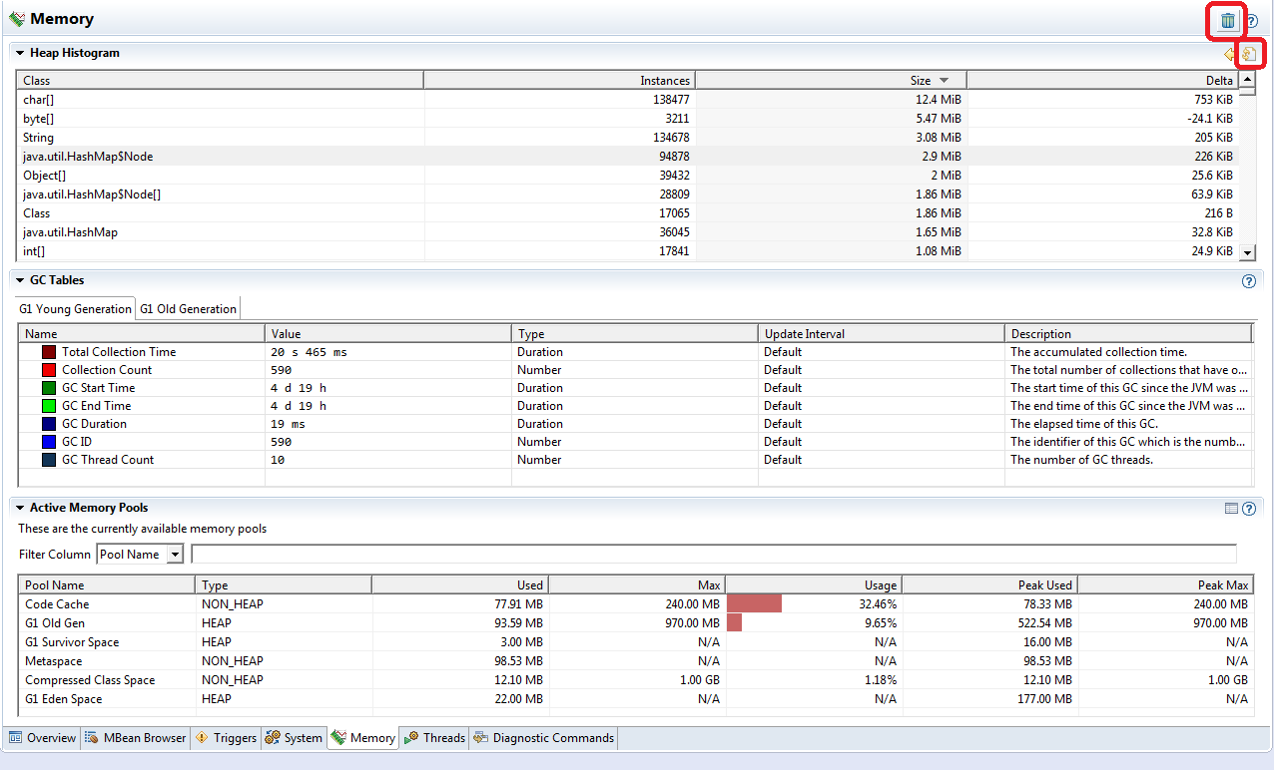
JMC
Java Mission Control
Memory tab
Heap generation
Minor & full GC Info

Slide 95
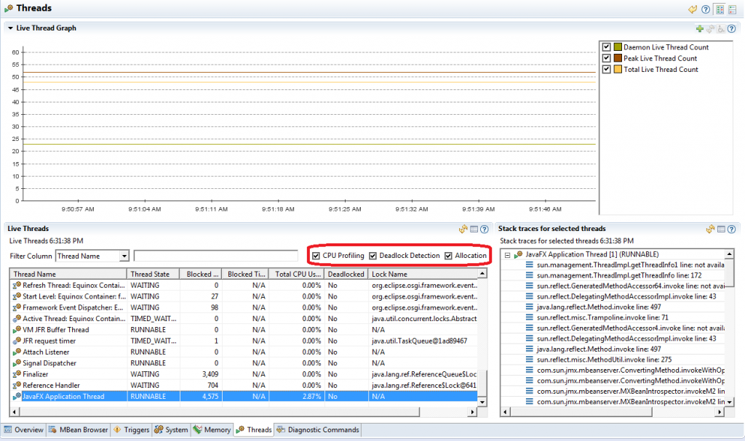
JMC
Java Mission Control
Threads tab
Thread state
Lock name
Deadlock
Blocked count
Per thread CPU usage
Amount of memory allocated by a given thread since it was started

Slide 96

JMC
Java Mission Control
Flight recorder - Initial screen
View JVM args
You may set
time range for analyzing

Slide 97
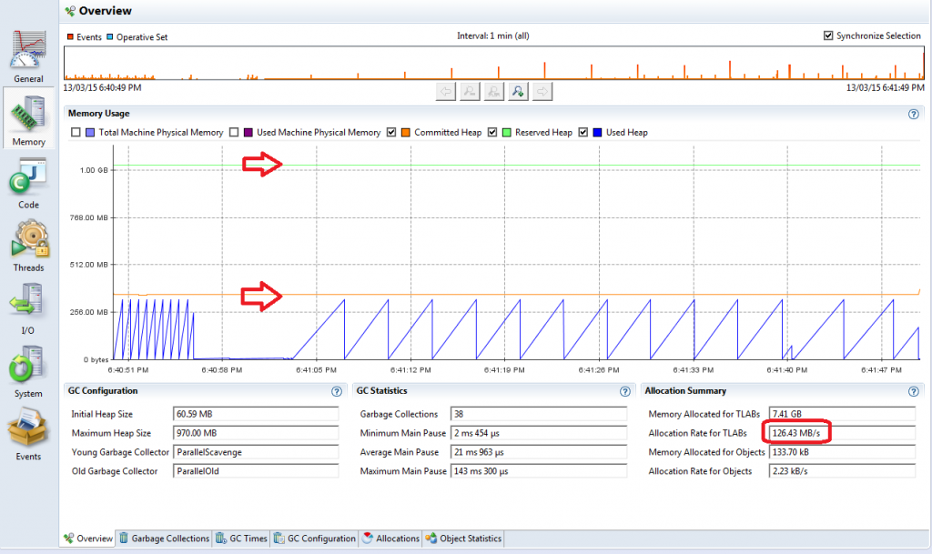
JMC
Java Mission Control
Flight recorder
memory tab
Machine RAM
Java heap usage
Garbage collections – when, why, for how long and how much space was cleaned up.
Memory allocation – inside / outside TLAB, by class/thread/stack trace.
Heap snapshot – number / amount of memory occupied by class name

Slide 98
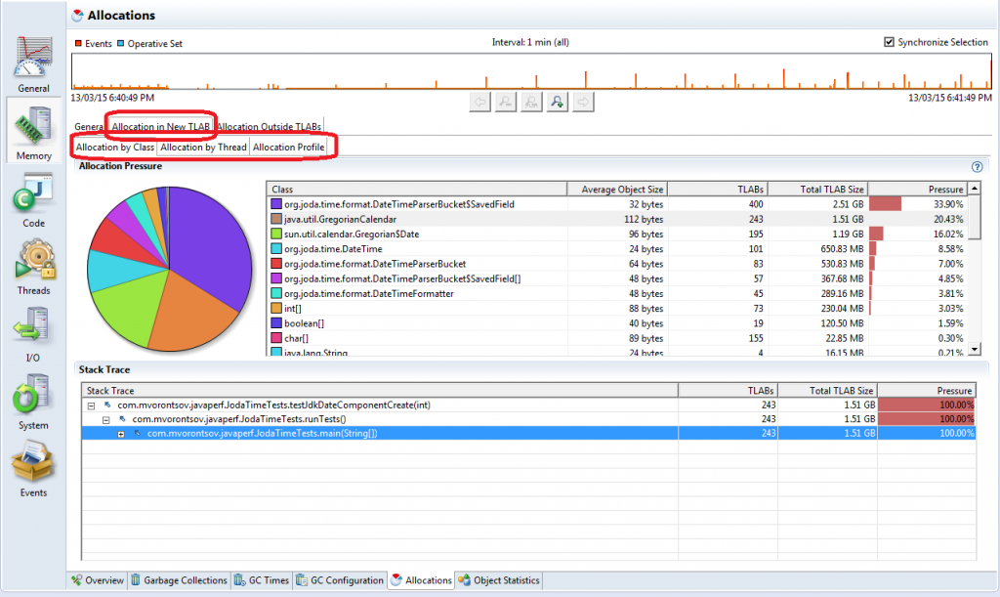
JMC
Java Mission Control
Flight recorder
allocation tab
Object allocations
By class
By thread

Slide 99
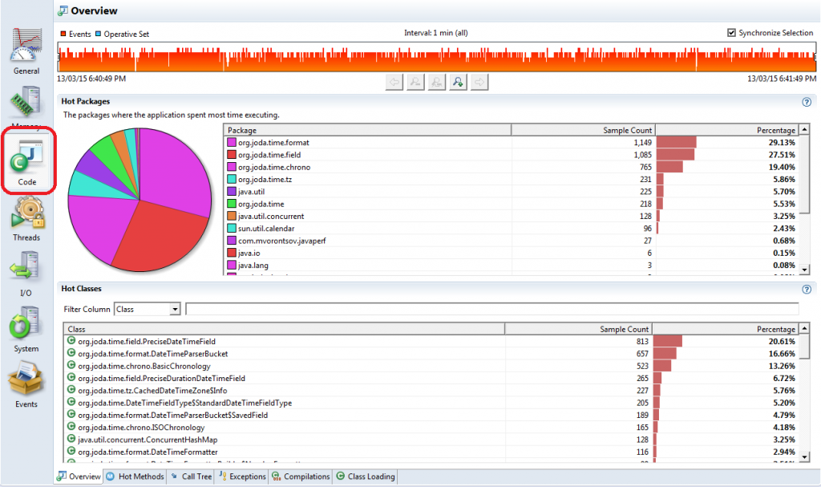
JMC
Java Mission Control
Flight recorder code tab
Method hotspots
Packages hotspots
Useful for CPU optimization

Slide 100
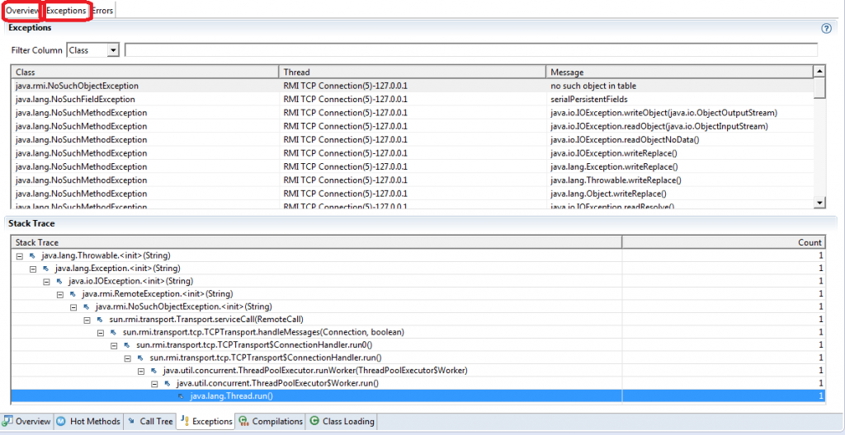
JMC
Java Mission Control
Other tabs
Exceptions
I/O
Threads

Slide 102
Java Concurrency
Basics brief
Executors
Callable & Future
Atomic Concurrent
Lock API (Lock, Criteria)
Barriers
Fork-Join

Slide 103
Subclassing Thread and Overriding run
public class SimpleThread extends Thread {
public SimpleThread(String str) {
super(str);
}
public void run() {
for (int i = 0; i < 10; i++) {
System.out.println(i + " " + getName());
try {
sleep((long)(Math.random() * 1000));
} catch (InterruptedException e) {}
}
System.out.println("DONE! " + getName());
}
}
Output:
0 Jamaica
0 Fiji
1 Fiji
1 Jamaica
2 Jamaica
2 Fiji
3 Fiji
…
6 Jamaica
7 Jamaica
7 Fiji
8 Fiji
9 Fiji
8 Jamaica
DONE! Fiji
9 Jamaica
DONE! Jamaica
Main method:
public class TwoThreadsTest {
public static void main (String[] args) {
new SimpleThread("Jamaica").start();
new SimpleThread("Fiji").start();
}
}
Notes:
The slide and the following two, demonstrate one of the two ways to implement threads in Java.
Ten times the name associated with the thread, is going to be printed, with some random delays between subsequent printings.

Slide 104
Implementing Runnable
public class SimpleRunnable implements Runnable{
public void run() {
for (int i = 0; i < 10; i++) {
System.out.println(i + " " + Thread.currentThread().getName());
try {
Thread.sleep((long)(Math.random() * 1000));
} catch (InterruptedException e) {}
}
System.out.println("DONE! " + Thread.currentThread(). getName());
}
}
Output:
0 Jamaica
0 Fiji
1 Fiji
1 Jamaica
2 Jamaica
2 Fiji
3 Fiji
…
6 Jamaica
7 Jamaica
7 Fiji
8 Fiji
9 Fiji
8 Jamaica
DONE! Fiji
9 Jamaica
DONE! Jamaica
Main method:
public class TwoThreadsTest {
public static void main (String[] args) {
SimpleRunnable runner=new SimpleRunnable ();
Thread t1=new Thread(runner,”Jamaica”);
Thread t2=new Thread(runner,”Fiji”);
t1.start();
t2.start();
}
}
Notes:
The slide and the following two, demonstrate one of the two ways to implement threads in Java.
Ten times the name associated with the thread, is going to be printed, with some random delays between subsequent printings.

Slide 105
The Life Cycle of a Thread
new
Thread
Alive area
Dead
Blocked pool
Thread.sleep()
Thread.yield()
join()
I/O
Thread.start()
Runnable
Running
JVM Scheduler
run() ends
Basic states of the Thread:
New Thread
Running
Not Runnable
Dead
Notes:
Thread states
Born state
Thread was just created
Ready state
Thread’s start method invoked
Thread can now execute
Running state
Thread is assigned a processor and running
Dead state
Thread has completed or exited
Eventually disposed of by system

Slide 106
States of the Thread – Not Runnable
Basic control:
Sleep – moves the thread to a non-Runnable state for a period of time (ms)
Usually the simplest way to delay threads or main
Note: blocks the thread at least to the specified time – not exactly
Yield – moves the Running thread to the Rannable pool (Equals to sleep(0))
Usually for giving other low priority thread a chance to run
Join – moves the running thread to a non-Runnable state until a specific thread ends
Delays the caller until the referenced thread ends
Is absolute – not like priority
All methods throws InterruptedException
When thread are out of the blocking state before time
Might happen due to OS activity
I/O Block – same occurs for connec(), read() & write()
Blocked threads returns to runnable state
never to running (!)
try {
Thread.sleep(3000)
} catch (InterruptedException e) {}
try {
Thread.yield()
} catch (InterruptedException e) {}
…
Thread t=new Thread(runner);
t.start();
try {
t.join()
} catch (InterruptedException e) {}
// all the work here happens after t ends
…

Slide 107
States of the Thread – Dead
the run method must terminate naturally
stop method – deprecated!!!
This method is inherently unsafe. Stopping a thread with Thread.stop causes it to unlock all of the monitors that it has locked (as a natural consequence of the unchecked ThreadDeath exception propagating up the stack)
Notes:
public final void stop()
Deprecated. This method is inherently unsafe. Stopping a thread with Thread.stop causes it to unlock all of the monitors that it has locked (as a natural consequence of the unchecked ThreadDeath exception propagating up the stack). If any of the objects previously protected by these monitors were in an inconsistent state, the damaged objects become visible to other threads, potentially resulting in arbitrary behavior. Many uses of stop should be replaced by code that simply modifies some variable to indicate that the target thread should stop running. The target thread should check this variable regularly, and return from its run method in an orderly fashion if the variable indicates that it is to stop running. If the target thread waits for long periods (on a condition variable, for example), the interrupt method should be used to interrupt the wait. For more information, see Why are Thread.stop, Thread.suspend and Thread.resume Deprecated?.

Slide 108
Daemon Threads
Threads keep on running even after main thread ends
Means that the VM still ‘on the air’ until the last thread dies
In order to kill a thread when system exits it has to be a daemon
Thread can be set to behave as daemon via setDaemon(boolean)
Thread can be checked via isDaemon()
Garbage collection is a daemon thread
therefore doesn’t last after system exit
That’s why sometimes object may never get the finalize() call
Notes:
The API for the Thread class includes a method called isAlive. The isAlive method returns true if the thread has been started and not stopped. If the isAlive method returns false, you know that the thread either is a New Thread or is Dead. If the isAlive method returns true, you know that the thread is either Runnable or Not Runnable. You cannot differentiate between a New Thread or a Dead thread. Nor can you differentiate between a Runnable thread and a Not Runnable thread.

Slide 109
The isAlive Method
Returns true if:
If the thread has been started and not stopped
the thread is Runnable or Not Runnable
Returns false if:
the thread is New Thread or Dead
Notes:
The API for the Thread class includes a method called isAlive. The isAlive method returns true if the thread has been started and not stopped. If the isAlive method returns false, you know that the thread either is a New Thread or is Dead. If the isAlive method returns true, you know that the thread is either Runnable or Not Runnable. You cannot differentiate between a New Thread or a Dead thread. Nor can you differentiate between a Runnable thread and a Not Runnable thread.

Slide 110
Synchronizing Threads
Separate, concurrently running threads do share data and must consider the state and activities of other threads
One such set of programming situations are known as producer/consumer scenarios where the producer generates a stream of data which then is consumed by a consumer
The code segments within a program that access the same object from separate, concurrent threads are called critical sections
In the Java language, a critical section can be a block or a method and are identified with the synchronized keyword
The Java platform then associates a lock with every object that has synchronized code.
Notes:
Producer-Customer without synchronization:
Buffer
Shared memory region
Producer thread
Generates data to add to buffer
Calls wait if consumer has not read previous message in buffer
Writes to empty buffer and calls notify for consumer
Consumer thread
Reads data from buffer
Calls wait if buffer empty
Synchronize threads to avoid corrupted data
Producer-Customer withsynchronization:
Synchronize threads to ensure correct data

Slide 111
Locking an Object - Example
public class Car{
...
public synchronized void drive(){
//this Car is locked by a Driver
…
//this Car is unlocked by a Driver
}
}
public class Car{
...
//It’s not synchronized now
public void drive(){…}
}
public class Person{
public void use(Car c){
synchronized(c){
…
c.drive();
…
}
}
}
Only one Driver can drive the Car at a time
Only one thread at a time can own an object’s monitor
More than one Driver can drive the Car at a time
Notes:
The code segments within a program that access the same object from separate, concurrent threads are called critical sections. In the Java language, a critical section can be a block or a method and are identified with the synchronized keyword. The Java platform then associates a lock with every object that has synchronized code. In the producer/consumer example, the put and get methods of the CubbyHole are the critical sections. The Consumer should not access the CubbyHole when the Producer is changing it, and the Producer should not modify it when the Consumer is getting the value. So put and get in the CubbyHole class should be marked with the synchronized keyword.
Here's a code skeleton for the CubbyHole class:
public class CubbyHole { private int contents; private boolean available = false; public synchronized int get() { ... } public synchronized void put(int value) { ... } } Note that the method declarations for both put and get contain the synchronized keyword. Hence, the system associates a unique lock with every instance of CubbyHole (including the one shared by the Producer and the Consumer). Whenever control enters a synchronized method, the thread that called the method locks the object whose method has been called. Other threads cannot call a synchronized method on the same object until the object is unlocked. So, when the Producer calls CubbyHole's put method, it locks the CubbyHole, thereby preventing the Consumer from calling the CubbyHole's get method:

Slide 112
Synchronization
new
Thread
Alive area
Dead
Blocked pool
Thread.sleep()
Thread.yield()
join()
I/O
block ends
interrupt()
Thread.start()
Runnable
Running
JVM Scheduler
run() ends
Synch block
released
Synchronized pool
Synch block
occupied

Slide 113
Using the notify and wait Methods
wait(), wait(long timeout)
Causes current thread to wait until another thread invokes the notify() method or the notifyAll() method for this object, or a specified amount of time has elapsed.
notify()
Wakes up a single thread that is waiting on this object's monitor
notifyAll()
Wakes up all threads that are waiting on this object's monitor
Notes:
Using the notifyAll and wait Methods
The CubbyHole stores its value in a private member variable called contents. CubbyHole has another private member variable, available, that is a boolean. available is true when the value has just been put but not yet gotten and is false when the value has been gotten but not yet put. So, here's one possible implementation for the put and get methods: public synchronized int get() { // won't work! if (available == true) { available = false; return contents; } } public synchronized void put(int value) { // won't work! if (available == false) { available = true; contents = value; } } As implemented, these two methods won't work. Look at the get method. What happens if the Producer hasn't put anything in the CubbyHole and available isn't true? get does nothing. Similarly, if the Producer calls put before the Consumer got the value, put doesn't do anything.

Slide 114
Using the notify and wait Methods
Alive area
new
Thread
Dead
Blocked pool
Thread.sleep()
Thread.yield()
join()
I/O
block ends
interrupt()
Thread.start()
Runnable
Running
JVM Scheduler
run() ends
Synch ends
interrupt()
wait()
interrupt()
notify()
Synchronized pool
Waiting pool

Slide 115
Precondition to wait and notify Methods
The current thread must own this object’s monitor
A thread becomes the owner of the object’s monitor in one of three ways:
By executing a synchronized instance method
By executing the body of a synchronized
For objects of type Class, by executing a synchronized static method
Only one thread at a time can own an object’s monitor
Notes:
You really want the Consumer to wait until the Producer puts something in the CubbyHole and the Producer must notify the Consumer when it's done so. Similarly, the Producer must wait until the Consumer takes a value (and notifies the Producer of its activities) before replacing it with a new value. The two threads must coordinate more fully and can use Object's wait and notifyAll methods to do so.
Here are the new implementations of get and put that wait on and notify each other of their activities:
public synchronized int get() {
while (available == false) {
try {
// wait for Producer to put value wait();
} catch (InterruptedException e) { }
}
available = false; // notify Producer that value has been retrieved
notifyAll();
return contents;
}

Slide 116
Reentrant Locks
The Java runtime system allows a thread to re-acquire a lock that it already holds because Java locks are reentrant
public class Reentrant {
public synchronized void a() {
b();
System.out.println("here I am, in a()");
}
public synchronized void b() {
System.out.println("here I am, in b()");
}
}
MyThread t=new MyThread( new Reentrant());
t.start(); //run() method calls Reentrant.a()
Output:
here I am, in b()
here I am, in a()
Notes:
The Java runtime system allows a thread to re-acquire a lock that it already holds because Java locks are reentrant. Reentrant locks are important because they eliminate the possibility of a single thread deadlocking itself on a lock that it already holds. Consider this class:
public class Reentrant { public synchronized void a() { b(); System.out.println("here I am, in a()"); } public synchronized void b() { System.out.println("here I am, in b()"); } } Reentrant contains two synchronized methods: a and b. The first synchronized method, a, calls the other synchronized method, b. When control enters method a, the current thread acquires the lock for the Reentrant object. Now, a calls b and because b is also synchronized the thread attempts to acquire the same lock again. Because Java supports reentrant locks, this works. The current thread can acquire the Reentrant object's lock again and both a and b execute to conclusion as is evidenced by the output:
here I am, in b() here I am, in a() In systems that don't support reentrant locks, this sequence of method calls would cause deadlock.

Slide 117
The method interrupt
Interrupts the thread
If the current thread is interrupted by another thread while it is waiting, then an InterruptedException is thrown
This exception is not thrown until the lock status of
this object has been restored as described above
This method should only be called by a thread that is the owner of this object's monitor
Notes:
public void interrupt()
Interrupts this thread. First the checkAccess method of this thread is called with no arguments. This may result in throwing a SecurityException.
public static boolean interrupted()
Tests whether the current thread has been interrupted. The interrupted status of the thread is cleared by this method. In other words, if this method were to be called twice in succession, the second call would return false (unless the current thread were interrupted again, after the first call had cleared its interrupted status and before the second call had examined it).
Returns:
true if the current thread has been interrupted; false otherwise.

Slide 118
Thread Local
Keeps state for individual threads
Each thread has its own independently initialized copy of the variable
Differs from local variables
Managed in the language level rather than stack management (makes thread stack lighter)
Obtain a direct access to data using the thread as a hash-map key
Used by threads to store / load session states between calls
java.lang.ThreadLocal
Data is simply accessible via get()/set() methods
Thread entry is automatically discarded when a thread dies
Notes:
public final void resume()
Deprecated. This method is used solely in conjunction with Thread.suspend and ThreadGroup.suspend, both of which have been deprecated, as they are inherently deadlock-prone. See Thread.suspend() for details.
Resumes all threads in this thread group. First, the checkAccess method of this thread group is called with no arguments; this may result in a security exception.
This method then calls the resume method on all the threads in this thread group and in all of its sub groups.
public final void suspend()
Deprecated. This method is inherently deadlock-prone. See Thread.suspend() for details.
Suspends all threads in this thread group. First, the checkAccess method of this thread group is called with no arguments; this may result in a security exception.
This method then calls the suspend method on all the threads in this thread group and in all of its subgroups.

Slide 119
Thread Local
Example:
public class MyThread extends Thread
{
// static Hashtable stuff;
public static ThreadLocal stuff = new ThreadLocal();
public void run() {
// each thread must have a different hashtable
Hashtable h= new Hashtable();
//load session data on hashtable
…
//assign it to ThreadLocal
stuff.set(h);
handleData();
}
public void handleData(){
if (((Hashtable)stuff.get()).containsValue("Foo"))
doSomething(); // run code which can refer to hash table
}
}
}
Notes:
public final void resume()
Deprecated. This method is used solely in conjunction with Thread.suspend and ThreadGroup.suspend, both of which have been deprecated, as they are inherently deadlock-prone. See Thread.suspend() for details.
Resumes all threads in this thread group. First, the checkAccess method of this thread group is called with no arguments; this may result in a security exception.
This method then calls the resume method on all the threads in this thread group and in all of its sub groups.
public final void suspend()
Deprecated. This method is inherently deadlock-prone. See Thread.suspend() for details.
Suspends all threads in this thread group. First, the checkAccess method of this thread group is called with no arguments; this may result in a security exception.
This method then calls the suspend method on all the threads in this thread group and in all of its subgroups.

Slide 120
Thread Executor
An implementation of java.util.concurrent.Executor
Thread Pool Executor
A thread pool service
Offers powerful control over the pool
Can expand and shrink the pool according to call intensity
Better since
Manages shared resources among threads
Offers monitoring and reporting [for example: no’ of completed tasks]
Supports Callable objects execution (not just Runnable) - later
Manages a fully featured queue
Min/max sizes
On-demand service
Keep-alive time
Can be shut down and reject calls
Offers scheduling assignments - better & lighter than Timers

Slide 121
Thread Executors
Executor queue types
Synchronous queue
means that a call is handled rapidly – if no available thread – a new one is constructed
max size is irrelevant and ignored
Blocking queue
means that threads are created until the queue is full (at max size)
then – queuing begins
All supports both Runnable & Callable

Slide 122
Callable
Callable is an interface with a single method
Callable<T> implementers must provide public <T> call() throws Exception
Similar to Runnable – run() in that they are both executed by threads
But differs with the following capabilities:
Returns a result of the execution
Throws checked exceptions
Several Callable objects can be executed with a single call to the Executor service
One thread can invoke several Callable objects during its life time

Slide 123
Callable
Example:
import java.util.concurrent.Callable;
public class ClientListener implements Callable<Request> {
private ClientInputStream in=null;
public ClientListener (ClientInputStream in){
this.in=in;
}
public Request call() throws ConnectionException {
try {
return in.acceptRequest();
}catch(Exception ex){
throw new ConnectionException (“Error processing client request”);
}
}
}

Slide 124
Callable
Void type safe Callable Example:
import java.util.concurrent.Callable;
public class VoidCallable implements Callable<Void> {
public Void call() throws Exception {
//do job
//Void type-safe return value must be NULL
return null;
}
}

Slide 125
Executors Utility Class
Creates the following:
FixedThreadPool
A fixed thread pool that will use only the given amount of threads to execute Runnable & Callable objects
If all threads are busy, Runnable objects that are not currently running – blocks
Asynchronous queue
ScheduledThreadPool
Offers the ability of scheduling Runnable & Callable objects execution

Slide 126
Executors Utility Class
Creates the following:
CachedThreadPool
Synchronous queue
Creates new threads every time a new execution is required and all threads are busy
Therefore
Non blocking queue
Max threads in the pool is irrelevant
Threads are removed automatically after waiting 60 sec for a task
SingleThreadExecutor
Handles all registered Runnable and Callable objects via a single thread

Slide 127
Executors Utility Class
All available through static methods
Most takes fixed or minimum pool size as int
Returns an Executor implementation [ExecutorService]
Threads are created according to
Queue type and policy
Queue thread factory implementation [later]
Each thread may invoke more than one Callable object
For example: when a fixed queue with the size of 2 is invoking 4 callable objects, 2 threads will be created and used to invoke all 4

Slide 128
Executors Utility Class
ExecutorService - execution methods
Future<Void> submit(Runnable)
Returns Future with null result
Doesn’t throws any exception
Is a non-blocking operation
Future<T> submit(Callable<T>)
Returns Future<T>
Is a non-blocking operation

Slide 129
Executors Utility Class
ExecutorService - execution methods
void execute(Runnable)
Specified in java.util.concurrent.Executor
Returns void
Doesn’t throws any exception
Is a non-blocking operation
List<Future<T>> invokeAll(Collection<Callable<T>>)
Specified in java.util.concurrent.ExecutorService
Returns and array of Future<type of the call() method result>
Throws InterruptedException
Is a blocking operation
<T> invokeAny(Collection<Callable<T>>)
Specified in java.util.concurrent.ExecutorService
Returns a single value [type of the call() method result] of the task that has completed
Other uncompleted tasks are canceled
Throws InterruptedException
Is a blocking operation

Slide 130
Thread Executor
Runnable Example:
public class Worker implements Runnable {
public void run() {
System.out.println("New Worker");
}
}
public class User{
public static void main(String args[]) {
Executor e = Executors.newFixedThreadPool(2);
e.execute(new Worker());
e.execute(new Worker());
e.execute(new Worker()); //probably will wait
}
}
Notes:
public final void resume()
Deprecated. This method is used solely in conjunction with Thread.suspend and ThreadGroup.suspend, both of which have been deprecated, as they are inherently deadlock-prone. See Thread.suspend() for details.
Resumes all threads in this thread group. First, the checkAccess method of this thread group is called with no arguments; this may result in a security exception.
This method then calls the resume method on all the threads in this thread group and in all of its sub groups.
public final void suspend()
Deprecated. This method is inherently deadlock-prone. See Thread.suspend() for details.
Suspends all threads in this thread group. First, the checkAccess method of this thread group is called with no arguments; this may result in a security exception.
This method then calls the suspend method on all the threads in this thread group and in all of its subgroups.

Slide 131
Thread Executor
Callable Example:
ExecutorService executor=Executors.newCachedThreadPool();
Callable<Request> client1=new ClientListener<Request>(new ClientInputStream (…));
Callable<Request> client2=new ClientListener<Request>(new ClientInputStream (…));
Callable<Request> client3=new ClientListener<Request>(new ClientInputStream (…));
//create a callable collection in oprder to execute all at once
Collection<Callable<Request>> col=new HashSet<Callable<Request>>();
col.add(client1);
col.add(client2);
col.add(client3);
try {
List<Future<Request>> requests = executor.invokeAll(col);
…
} catch (InterruptedException e) { … }
Completed workers are those who
Executed call() and returned T as a result
Failed with exception – result is null
Cancelled
invokeAny & invokeAll catches call()
exceptions but doesn’t delegate them
Notes:
public final void resume()
Deprecated. This method is used solely in conjunction with Thread.suspend and ThreadGroup.suspend, both of which have been deprecated, as they are inherently deadlock-prone. See Thread.suspend() for details.
Resumes all threads in this thread group. First, the checkAccess method of this thread group is called with no arguments; this may result in a security exception.
This method then calls the resume method on all the threads in this thread group and in all of its sub groups.
public final void suspend()
Deprecated. This method is inherently deadlock-prone. See Thread.suspend() for details.
Suspends all threads in this thread group. First, the checkAccess method of this thread group is called with no arguments; this may result in a security exception.
This method then calls the suspend method on all the threads in this thread group and in all of its subgroups.

Slide 132
Future
Future<T>
A result wrapper
Is returned from both blocking & non-blocking execution
For uncompleted execution –
Future.get() blocks until completed
Execution can be investigated via Future.isDone(), Future.isCancelled()
Execution can be canceled via Future.cancel()
For completed execution –
Future.get() returns immediately

Slide 133
Future
Future<T>
Get() returns
T – when execution successfully completed
If the execution is based on Callable<T> - it might end with T or exception
If the execution is based on Runnable – it always returns null (Future<Void>)
Execution Exception
Get() throws checked Exception
In case of Callable throwing exception – it will be wrapped by Future exception
Use e.getCause() in order to get the actual execution exception

Slide 134
Future
Getting Future with Runnable Example:
public class Worker implements Runnable {
public void run() {
System.out.println("New Worker");
}
}
public class User{
public static void main(String args[]) {
Executor e = Executors.newFixedThreadPool(2);
Future<Void> f = e.submit(new MyRunnable());
f.get();
//we get here only after the task is completed…
}
}
Notes:
public final void resume()
Deprecated. This method is used solely in conjunction with Thread.suspend and ThreadGroup.suspend, both of which have been deprecated, as they are inherently deadlock-prone. See Thread.suspend() for details.
Resumes all threads in this thread group. First, the checkAccess method of this thread group is called with no arguments; this may result in a security exception.
This method then calls the resume method on all the threads in this thread group and in all of its sub groups.
public final void suspend()
Deprecated. This method is inherently deadlock-prone. See Thread.suspend() for details.
Suspends all threads in this thread group. First, the checkAccess method of this thread group is called with no arguments; this may result in a security exception.
This method then calls the suspend method on all the threads in this thread group and in all of its subgroups.

Slide 135
Future
Getting Future with Callable Example:
ExecutorService executor=Executors.newCachedThreadPool();
Callable<Request> client1=new ClientListener<Request>(new ClientInputStream (…));
Callable<Request> client2=new ClientListener<Request>(new ClientInputStream (…));
Callable<Request> client3=new ClientListener<Request>(new ClientInputStream (…));
//create a callable collection in oprder to execute all at once
Collection<Callable<Request>> col=new HashSet<Callable<Request>>();
col.add(client1);
col.add(client2);
col.add(client3);
try {
List<Future<Request>> requests = executor.invokeAll(col);
for(Future<Request> f: requests){
try{
Request curr=f.get();
}catch(Exception e){
Exception origin = e.getCause();
}
}
…
} catch (InterruptedException e) { … }
Notes:
public final void resume()
Deprecated. This method is used solely in conjunction with Thread.suspend and ThreadGroup.suspend, both of which have been deprecated, as they are inherently deadlock-prone. See Thread.suspend() for details.
Resumes all threads in this thread group. First, the checkAccess method of this thread group is called with no arguments; this may result in a security exception.
This method then calls the resume method on all the threads in this thread group and in all of its sub groups.
public final void suspend()
Deprecated. This method is inherently deadlock-prone. See Thread.suspend() for details.
Suspends all threads in this thread group. First, the checkAccess method of this thread group is called with no arguments; this may result in a security exception.
This method then calls the suspend method on all the threads in this thread group and in all of its subgroups.

Slide 136
Executors Thread Factory
Executors can be created with
Default thread factory
Simply generates threads when asked to
Queue type is the one that responsible for using the factory according to its policy
Custom thread factory
Is developed as a separate class and implements java.util.concurrent.ThreadFactory
Is assigned to the executor via Executors static methods
May be used for extra logic when creating threads used by Executors like:
Defining thread pool size
Set threads with customized names & priorities
Provide daemon threads
public class SimplestThreadFactory implements ThreadFactory{
public Thread newThread(Runnable r) {
return new Thread(r);
}
}

Slide 137
Executors Thread Factory
Example:
public class CustomThreadFactory implements ThreadFactory{
private int priority;
private boolean daemon;
public CustomThreadFactory (int priority, boolean daemon){
this.priority=priority;
this.daemon=daemon;
}
public Thread newThread(Runnable r) {
Thread newThread=new Thread(Runnable);
newTread.setPriority(priority);
newThread.setDaemon(daemon);
return newThread;
}
}
CustomThreadFactory factory = new CustomThreadFactory (5,true);
ExecutorService executor=Executors.newCachedThreadPool(factory);
Usage:

Slide 138
Fork-Join
Lightweight processing with ForkJoinTask<V> & Pool
Some terms:
Heavyweight processing = processing in separate stack
Threads helps in that
Stack values has to be re-assigned every time thread uses CPU time
Synchronization might be needed
Known as ‘fork’
Lightweight processing = processing in the same stack
Linear processing
Processing time might be short, long or very long..
For short time – we can use the same thread or new thread
For long time – we can use new thread

Slide 139
Fork-Join
For very long tasks we might want to:
Split task into small independent parts
Fork each part to solve it separately
In the same thread pool dedicated to that long task
Join all parts
Compose the result out of them

Slide 140
Fork-Join
Java 7 offers:
ForkJoinTask – lightweight task (like Callable-Future)
RecursiveAction – a task that doesn’t return a result
RecursiveTask<E> - a task that results in E type
Both has invokeAll(..) method to fork other subtasks
ForkJoinPool – An ExecutorService implementation
Designed for forking tasks and its subtasks
Takes number of processors to its constructor
Default constructor is set according to the Runtime.availableProcessors()

Slide 141
Fork-Join
Fork-Join
Example:
public class ElementTask extends RecursiveAction{
private Node n;
public ElementTask(Node n) {this.n=n;}
@Override
public void compute(){
if(node.getNodeValue().equals(“leaf”)){
….. Process node data
}else { // node is composite of sub-leafs…..
NodeList subs=n.getChildNodes();
Collection<ElementTask> subTasks=new HashSet<>()
for(int i=0;i<subs.getLength();i++){
subTasks.add(new ElementTask(subs.item(i)));
}
invokeAll(subTasks ); //registers more tasks to the pool..
}
}
}
ElementTask t=new ElementTask(xmlDocumentNode);
ForkJoinPool pool=new ForkJoinPool ();
pool.invoke(t);

Slide 142
CompletableFuture
Since Java 8
CompletionStage<T> interface
Used for breaking tasks into conditional continues sub-tasks
CompletableFuture
Implements CompletableStage
Provides operations for creating sub-tasks pipelines
Supports LAMBDA exp.

Slide 143
CompletableFuture
Provides operations like:
thenAccept(Consumer<? super T> action)
supplyAsync(Supplier<U> supplier)
thenApply(Function<? super T,? extends U> fn)
thenRun(Runnable action)
All result with CompletionStage<T> - so pipelines may be easily codes
All may use current thread or obtain different one from given executor - asyncXXX()
All may be executed on different executors than ForkJoinPool..commonPool()

Slide 144
CompletableFuture
Examples:
Methods relates to other CompletableStage<T> instances:
acceptEither(CompletionStage<? extends T> other, Consumer<? super T> action)
applyToEither(CompletionStage<? extends T> other, Function<? super T,U> fn)
runAfterBoth(CompletionStage<?> other, Runnable action)
runAfterEither(CompletionStage<?> other, Runnable action)
Method ref pipeline:
CompletableFuture.supplyAsync(me::findRemoteControl)
.thenApply(codi::searchMovie)
.thenAccept(me::watchMovie);
LMBDA Exp. Pipline:
CompletableFuture.supplyAsync(()->me.findRemoteControl(“under the sofa”))
.thenApply((rc)-> codi.favorateChannel(rc,”Pulp Fiction”)
.thenAccept((mov)->me.watchMovie(mov));

Slide 145
Concurrent Atomic
java.util.concurrent.atomic package
Provides thread-safe wrappers of atomic data
Wait, isn’t it ‘volatile’ keyword responsibility?

Slide 146
Concurrent Atomic
Volatile
Synchronizes access to primitive allocations
Should be used when variables are about to be shared and modified by multiple threads
Volatile compared with synchronization:
May ‘synchronize’ null values
Can be applied to primitives as well
Well supported since Java 5 (don’t use it in older versions)
Non-blocking (just for the single action itself…)

Slide 147
Concurrent Atomic
So, why do we need Atomic locks if we can use volatile?
volatile cannot block, means we cannot manipulate a value and read it in an atomic context
Volatile doesn’t solve this:
Volatile doesn’t support conditional updates…
int x=100;
…
if(x==200){
x=x*10;
x++;
}

Slide 148
Concurrent Atomic
Concurrent Atomic wrappers
Provides volatile access to its value
Extends it with general methods
set(), get()
compareAndSet(expectedValue, updatedValue )
Extends it with type specific methods
For int: addAndGet(int delta), decrementAndGet() …

Slide 149
Concurrent Atomic
A little about compareAndSet(expected, updated)
Performs volatile read on wrapped value
If expected == value
Volatile updates the value with updated
Return true
If expected != value
Return false
Threads might retry to change data on ‘false’ result
But are not blocked due to this method invocation

Slide 150
Concurrent Atomic
List of atomic wrappers:
AtomicBoolean
AtomicInteger
AtomicIntegerArray
AtomicLong
AtomicLongArray
AtomicReference
AtomicReferenceArray

Slide 151
Concurrent Atomic
Example:
private AtomicInteger a=new AtomicInteger(100);
..
public int getValue(){
return a.get();
}
public boolean update (int current, int value){
return a.compareAndSet(current,value);
}
public int increment(){
return a.incrementAndGet();
}

Slide 152
Concurrent Locking
java.util.concurrent.locks
Provides framework for conditional locking
Much flexible than the classical build-in mechanism
Lock – defines the lock policy
Condition – manipulate executions on a Lock
Read-Write lock – combination of 2 locks
One for reading and one for writing

Slide 153
Concurrent Locking
Lock interface
lock() - acquires a lock
unlock() – releases it
lockInterruptibly() – locks until thread gets interrupted
tryLock() – locks only if it is free on execution
tryLock(long time, TimeUnit unit) – waits for it to be free and lock
newCondition() - returns a condition bound to the lock

Slide 154
Concurrent Locking
Condition interface
Offers enhanced Lock control
Multiple conditions can be obtained and managed on a Lock
Methods:
signal() – wakes up waiting thread
signalAll() – wakes up all waiting threads on that Lock
await() – causes calling thread to wait until signaled or interrupted
await(long time, TimeUnit unit), await(long nanos)

Slide 155
Concurrent Locking
Concrete Locks
ReentrantLock
Acts like classic thread synchronization
Thread can lock only if not locked already
Many Conditions can be created
Provides informative methods
isLocked()
getLockQueueLength()

Slide 156
Concurrent Locking
Concrete Locks
ReentrantReadWriteLock
Maintains a fair read-write time slicing
Only one thread can write at a time
Several reader threads can read at the same time
readLock() obtains the Lock for reading
writeLock() obtains the lock for writing

Slide 157
Concurrent Locking
Simple Example:
private ReentrantLock lock=new ReentrantLock();
..
public void method(){
lock.lock();
// do some thread sensitive tasks
lock.unlock();
}

Slide 158
Concurrent Locking
Concrete Locks
CyclicBarrier
Blocks specified number of threads – then releases all
Barrier is created with a given counter
Threads uses barrier await() method to block
When the number of waiting threads reached the counter – all waiting threads are released
Cyclic means - A reusable threads barrier

Slide 159
Concurrent Locking
Simple Example - CyclicBarrier:
public class Task implements Runnable{ private CyclicBarrier barrier; public Task(CyclicBarrier barrier) { this.barrier = barrier; } @Override public void run(){ try { System.out.println(Thread.currentThread().getName() + " is waiting on barrier"); barrier.await(); System.out.println(Thread.currentThread().getName() + " has crossed the barrier"); } catch (InterruptedException ex) { …
}
}
}

Slide 160
Concurrent Locking
Simple Example - CyclicBarrier:
public static void main(String args[]) { final CyclicBarrier cb = new CyclicBarrier(3, new Runnable(){ @Override public void run(){ //This task will be executed once all thread reaches barrier System.out.println("All parties are arrived at barrier, lets play"); } }); Thread t1 = new Thread(new Task(cb), "Thread 1"); Thread t2 = new Thread(new Task(cb), "Thread 2"); Thread t3 = new Thread(new Task(cb), "Thread 3"); t1.start(); t2.start(); t3.start(); }
Output:
Thread 1 is waiting on barrier Thread 3 is waiting on barrier Thread 2 is waiting on barrier All parties are arrived at barrier, lets play Thread 3 has crossed the barrier Thread 1 has crossed the barrier Thread 2 has crossed the barrier

Slide 161
Concurrent Locking
Concrete Locks
CountDownLatch
Blocks threads – when counter reached zero (0) – releases all threads
CountDownLatch is created with a given counter
Threads uses await() method to block
countDown() method decrements the counter – and if the counter reaches zero (0) – all waiting threads are released
Unlike CyclicBarrier, cannot be reset and reused

Slide 162
Concurrent Locking
Simple Example - CountDownLatch:
public class Task implements Runnable{ private CountDownLatch cdl; public Task(CountDownLatch cdl) { this.cdl = cdl; } @Override public void run(){ try { System.out.println(Thread.currentThread().getName() + " is waiting on count down latch");
//here – part of the thread job – is to update the counter when finished
cdl.countDown();
cdl.await(); System.out.println(Thread.currentThread().getName() + " has crossed the count down latch"); } catch (InterruptedException ex) { …
}
}
}

Slide 163
Concurrent Locking
Concrete Locks
Semaphore
Controls threads access to limited resources
Semaphore is created with a given ‘fair’ flag
Fairness is trying to manage first-in-first-out policy on blocked threads
Threads uses tryAcquire(maxWait, TimeUnit) to lock
release() / release(numOfThreadsToPermit) – releases the lock

Slide 164
Concurrent Locking
Simple Example – Semaphore & resource pool:
public class ResourcePool<T> {
private final Semaphore sem = new Semaphore(MAX_RESOURCES, true);
private final Queue<T> resources = new ConcurrentLinkedQueue<T>();
public T getResource(long maxWaitMillis) throws InterruptedException, ResourceCreationException {
// First, get permission to take or create a resource
sem.tryAcquire(maxWaitMillis, TimeUnit.MILLISECONDS);
// Then, actually take one if available...
T res = resources.poll();
if (res != null) return res;
// ...or create one if none available
try {
return createResource();
} catch (Exception e) {
// release if we failed to create a resource!
sem.release();
throw new ResourceCreationException(e); }
}
public void returnResource(T res) {
resources.add(res);
sem.release();
}
}

Slide 165
Concurrent Locking
Reentrant with Conditions Example:
public class BoundedBuffer {
final Lock lock = new ReentrantLock();
final Condition notFull = lock.newCondition(); //if not full - execute
final Condition notEmpty = lock.newCondition(); //if not empty - execute
final ArrayList items = new ArrayList(100);
public void put(Object x) throws InterruptedException {
lock.lock();
try {
while (items.size==100)
notFull.await();
items.add(x);
notEmpty.signal();
} finally { lock.unlock(); }
}
public Object pop() throws InterruptedException {
lock.lock();
try {
while (item.size()== 0)
notEmpty.await();
Object x = items.remove(items.size()-1);
notFull.signal();
return x; }
finally { lock.unlock(); }
}
}

Slide 166
Concurrent Locking
Java 8 - Optimistic reading
When a reader obtains a non-exclusive lock on a resource it receives a stamp
On any writer update to the resource – the stamp gets updated
Readers may use their stamps in order to validate the resource
If the stamp is the same as the one in the source – no writers obtained any lock
Writers always update the resource stamp on completion
Stamps are much like ‘version’ in Hibernate/JPA
StampedLock class
tryOptimisticRead()
used by readers in order to manage optimistic read locks on a resource
results with a non-zero stamp or zero if exclusively locked
validate(stamp)
Returns true if resource has the same stamp (means no other writer flushed data)

Slide 167
Concurrent Collections
We got:
Old collections which are synchronized
Collections.synchronizedXXX(…)
So what’s the point?

Slide 168
Concurrent Collections
Basic synchronization offers poor locking logic
No reading/writing considerations in Lists & Sets….
Maps locks – no matter which key is used….
Instead of using ‘synchronized’ we can:
Use ReadWriteLock for Lists & Sets
Manage Lock instances according to keys for Maps
Or simply use the concurrent collections Java provides

Slide 169
Concurrent Collections
Working with concurrent collections
ConcurrentModificationException are never thrown
So, how does it work exactly ??
Operations are done in a ‘dirty’ manner
When using clear() while other threads produces values
– you might not remove all objects
When using putAll()/addAll() while other threads consumes values
– you might end up with some missing objects
size() might be inaccurate

Slide 170
Concurrent Collections
Java concurrent collection classification:
Queue
put(), offer() to insert
poll(), remove() to delete
peek() – to view
Map
Super interfaces are:
BlockingQueue
ConcurrentMap

Slide 171
Concurrent Collections
Collection
Queue
BlockingQueue
PriorityQueue
ConcurrentLinkedQueue
Deque
ConcurrentLinkedDeque
LinkedList
BlockingDeque
PriorityBlockingQueue
ArrayBlockingQueue
SynchronousQueue
DelayQueue
LinkedBlockingQueue
TransferQueue
LinkedBlockingDeque
LinkedTransferQueue

Slide 172
Concurrent Collections
Map
ConcurrentMap
ConcurrentHashMap
ConcurrentNavigableMap
ConcurrentSkipListMap

Slide 173
Concurrent Collections
BlockingQueue
Null values are not permitted
Manages remaining capacity
Might be bounded. If not, always shows Integer.MAX_VALUE
take() blocks when empty
put() blocks when remaining capacity = 0
Atomic operations are thread-safe

Slide 174
Concurrent Collections
BlockingQueue – cont.
Non-blocking methods
add() return true on success and IllegalStateEx if full
offer() return true on success and false if full
poll() retrieves element or null if queue is empty
Bulk operations ( addAll(), containsAll()… )
Might partially execute and fail with exception

Slide 175
Concurrent Collections
ConcurrentMap
Offers atomic locks
Key-based locks for put() & get()
Additional methods
putIfAbsent(key,val) – assigns val if key has null value
remove(key,val) – removes entry if V equals current value
replace(key,val) – replaces current value with val
replace(key,val,nv) – assigns nv if current value equals val

Slide 176
Concurrent Collections
Concrete Blocking Queues
ArrayBlockingQueue
Based on Java Array
Once created, cannot be resized
Constructor accepts capacity & ‘fair’ flag
true = consumer & producer thread goes through FIFO queue
false = no thread queue – might lead to threads starvation
SynchronousQueue
Blocking queue with fixed zero size
Consumer poll() returns when producer offer() in executed

Slide 177
Concurrent Collections
Concrete Blocking Queues
PriorityBlockingQueue
Sorted blocking queue
Uses natural ordering (Comparable<T>)
LinkedBlockingQueue
Same functionality as ArrayBlockingQueue – but,
Backed by linked list (better for adding and removing elements)
Capacity can be specified

Slide 178
Concurrent Collections
Concrete Blocking Queues
DelayQueue
Unbounded blocking queue
offer(e, timeout, timeUnit) – adds element with expiration time
poll() – results with null, if no element expired yet
Elements are organized according to their expiration

Slide 179
Concurrent Collections
Concrete Blocking Queues
TransferQueue interface
Offered in JSE 7 release
Extends BlockingQueue
Allows a producer to use the queue in 2 methods
put() – as always, blocks when full or adds and returns
transfer() – which blocks until consumers uses take() or poll()
LinkedTransferQueue
TransferQueue linked-list based implementation

Slide 180
Concurrent Collections
Concrete Blocking Queues
BlockingDequeue interface
Double-ended blocking queue
Concrete class: LinkedBlockingDequeue
First Element (Head)
 | Throws exception | true/false | Blocks | Times out
Insert | addFirst(e) | offerFirst(e) | putFirst(e) | offerFirst(e, time, unit)
Remove | removeFirst() | pollFirst() | takeFirst() | pollFirst(time, unit)
Examine | getFirst() | peekFirst() | not applicable | not applicable
Last Element (Tail)
 | Throws exception | true/false | Blocks | Times out
Insert | addLast(e) | offerLast(e) | putLast(e) | offerLast(e, time, unit)
Remove | removeLast() | pollLast() | takeLast() | pollLast(time, unit)
Examine | getLast() | peekLast() | not applicable | not applicable

Slide 181
Concurrent Collections
Concrete Concurrent Maps
ConcurrentHashMap
Acts like hash-map in the sense of maintaining pairs
get() (read) doesn’t block
put() & set() uses atomic locks
Basically the whole table never gets synchronized

Slide 182
Concurrent Collections
Concrete Concurrent Maps
ConcurrentHashMap – cont.
Constructor parameters: (IMPORTANT!)
- initial capacity (default: 16)
- load factor –
Close to zero means no collisions even with weak hash function
But will require lot of memory for hash values
Leave at default value - 0.75 - reasonable for java hash function
- concurrency level –
Sets the number of producer queues for this Map
Default is 16 (as default initial size)
Set according to the expected number of writer / producer threads
Low number might lead to writer / producer contentions

Slide 183
Concurrent Collections
Concrete Concurrent Maps
ConcurrentNavigableMap interface
Base interface for concurrent sorted map, extends SortedMap<K,V>
Provides enhanced map functionalities
ceilingKey(K) – return the next key greater than or equals to K
floorKey(K) - return the next key less than or equals to K
lowerKey(K), higherKey(K)
lastEntry(), firstEntry()
pollLastEntry(), pollFirstEntry() - removes

Slide 184
Concurrent Collections
Concrete Concurrent Maps
ConcurrentNavigableMap interface – cont.
Offers some views on the Map table
headMap(toKey) – returns sub-map with all keys less than toKey
tailMap(fromKey) - returns sub-map with all keys greater than fromKey
subMap(fromKey, toKey)
all takes ‘inclusive’ flag to include keys equals to fromKey/toKey
Supports reversed iteration
descendingMap() - returns a reversed view of the map
descendingKeySet() returns a reversed key NavigableSet<K>

Slide 185
Concurrent Collections
Concrete Concurrent Maps
ConcurrentSkipListMap<K,V>
ConcurrentNavigableMap implementation
Uses SkipLists for fast search on sorted lists
Maintains hierarchical subsequences
Allows skipping range of irrelevant objects while searching

Slide 186
Java Reflection
Purpose
Capabilities
Examining classes and invoking object methods
Manipulating objects
Working with Arrays
Java 1.5 enhancements

Slide 187
Purpose
Represents, or reflects, the following in the running Java Virtual Machine:
Classes
Interfaces
Objects
Useful for
manipulating known & unknown classes
writing development tools such as
Browsers
Debuggers
GUI builders
Code generators

Slide 188
Purpose
Do not use for:
Creating method references to native methods
You should rather implementing it in java
Problematic debugging and tracking
Wrap native code (prefer JNI)
Note ! Reflection breaks encapsulation
Private fields are visible and accessible
Final fields can be populated

Slide 189
Capabilities
Determine the class of an object
Get information about a class's modifiers, fields, methods, constructors, and super-classes
Describe primitives
Find out what constants and method declarations belong to an interface
Create an instance of a class whose name is not known until runtime
Get and set the value of an object's field, even if the field name is unknown to your program until runtime
Invoke a method on an object, even if the method is not known until runtime
Create a new array, whose size and component type are not known until runtime, and then modify the array's components

Slide 190
Examining classes
Why and when
Retrieving Class objects
Getting class name
Checking if the Class reflects an Interface
Getting class modifiers
Identifying implemented Interfaces
Examining the class fields
Examining the class constructors
Discovering class methods

Slide 191
Examining classes
Required for class browsing
Need to know the class infrastructure
For example – list of class constructors
Is done via java.lang.Class
The JRE maintains a Class object to reflect classes
Class instances are immutable
Also represent Interfaces
Each living object hold a reference to its Class

Slide 192
Examining classes
Retrieving Class objects
From an instance
By specifying the class name as a String
Checked at runtime
Portable
By specifying the class name at compile time
MyObject obj=new MyObject();
Class class= obj.getClass();
Class class= Class.forName(“myPackage.MyObject”);
Class class= myPackage.MyObject.class;

Slide 193
Examining classes
Getting class name
Is done via the getName() & toString() methods
If primitive is reflected – the name of the primitive is returned
Returns a fully qualified name of the object/class reflected
import java.lang.reflect.*;
Import java.util.Date;
public class SampleName {
public static void main(String[] args) {
Date d = new Date();
printName(d);
}
static void printName(Object o) {
Class c = o.getClass();
String s = c.getName();
System.out.println(s);
}
}
The sample program prints the following line: java.util.Date

Slide 194
Examining classes
Checking if the Class reflects an Interface
Is done via isInterface() method
public static void verifyInterface(Class c) {
String name = c.getName();
if (c.isInterface()) {
System.out.println(name + " is an interface.");
} else {
System.out.println(name + " is a class.");
}
}

Slide 195
Examining classes
Identifying implemented Interfaces
Is done by the getInterfaces() method
Returns an array of Classes represents the Implemented interfaces
public static void printInterfaceNames(Object o) {
Class c = o.getClass();
Class[] theInterfaces = c.getInterfaces();
for (int i = 0; i < theInterfaces.length; i++) {
String interfaceName = theInterfaces[i].getName();
System.out.println(interfaceName);
}
}
Calling this method with a RandomAccessFile instance will generate the
following output:
java.io.DataOutput
java.io.DataInput
Note that the interface names printed are fully qualified

Slide 196
Examining classes
Getting class modifiers
Is done via the getModifiers() method
The method returns an int value that can be examined using java.lang.reflect.Modifiers class
public static void printModifiers(Object o) {
Class c = o.getClass();
int m = c.getModifiers();
if (Modifier.isPublic(m))
System.out.println("public");
if (Modifier.isAbstract(m))
System.out.println("abstract");
if (Modifier.isFinal(m))
System.out.println("final");
}
The output of the sample method with a given String object reveals
that the modifiers of the String class are public and final:
public
final

Slide 197
Examining classes
Modifiers can be checked also on:
constructors
methods
data members
Use method isAccessible() to check accessibility
The method is available for any AccessibleObject implementer [Constructor, Method, Field]
AccessibleObject also supports setting accessibility using the setAccessible(boolean) method
Enables or disables access check by the VM
May throw security exception
For final members – after calling setAccessible() on non-populated final field – it can be populated via reflection

Slide 198
Examining classes
Examining class fields
Done via getFields() method that returns public Field array
Done via getDeclaredFields() method that returns all Field array
Field class provides the following abilities:
Getting field name – getName()
Getting field type – getType() which returns a Class
Set<type> method to assign a Field with a value to an Object
(is done on a field with the same name of this Field instance and type specified in the method name)
Get modifiers – getModifiers()
Get<type> to read value of static members from an object
(is done on a field with the same name of this Field instance and type specified in the method name)

Slide 199
Examining classes
Examining class fields - example
public static void printFieldNames(Object o) {
Class c = o.getClass();
Field[] publicFields = c.getFields();
for (int i = 0; i < publicFields.length; i++) {
String fieldName = publicFields[i].getName();
Class typeClass = publicFields[i].getType();
String fieldType = typeClass.getName();
System.out.println("Name: " + fieldName + ", Type: " + fieldType);
}
}
The output of the sample program is:
Name: sum, Type: int
Name : word, Type: java.lang.String

Slide 200
Examining classes
Discovering class constructors
is done for public via getConstructors() method
is done for all via getDeclaredConstructors() method
returns a Constructor array
Constructor class supports:
getting constructor name
getting constructor parameters as Class array
creating new instance using the newInstance(Object params) method [where parameters are sent as objects and primitives are wrapped in wrapper classes]

Slide 201
Examining classes
Discovering class constructors - example
import java.lang.reflect.*;
import java.awt.*;
public class SampleConstructor {
public static void main(String[] args) {
Rectangle r = new Rectangle();
showConstructors(r);
}
public static void showConstructors(Object o) {
Class c = o.getClass();
Constructor[] theConstructors = c.getConstructors();
for (int i = 0; i < theConstructors.length; i++) {
System.out.print("( ");
Class[] parameterTypes = theConstructors[i].getParameterTypes();
for (int k = 0; k < parameterTypes.length; k ++) {
String parameterString = parameterTypes[k].getName();
System.out.print(parameterString + " ");
}
System.out.println(")");
}
}
}
The output of the sample program is:
( )
( int int )
( int int int int )
( java.awt.Dimension )
( java.awt.Point )
( java.awt.Point java.awt.Dimension )
( java.awt.Rectangle )

Slide 202
Examining classes
Discovering class methods
is done for public via getMethods() method
Is done for all via getDeclaredMethods() method
returns a Method array
Method class supports:
getting method name
getting method parameters as Class array
getting returned type
invoke – this method takes the instance to call and the Object[] of parameters to send. the method returns the returned value as an Object

Slide 204
Manipulating Objects
Creating objects
Getting fields values
Setting fields values
Invoking methods

Slide 205
Manipulating Objects
Creating objects
Class supports a call to the default constructor
When constructor expects arguments do the following:
load the required constructor as a Constractor
explore the constructor signature if needed/unknown
generate an object array with ordered parameters [where primitives values are wrapped in a matching wrapper class]
invoke the constructor using the Constructor’s method: newInstance(Object[] initArgs)
myPackage.MyObject obj=null;
obj=(myPackage.MyObject)Class.forName(“myPackage.MyObject”).newInstance();

Slide 206
Manipulating Objects
Creating objects - example
public static void main(String[] args) {
Rectangle rectangle;
Class rectangleDefinition;
Class[] intArgsClass = new Class[] {int.class, int.class};
Integer height = 12;
Integer width = 34;
Object[] intArgs = new Object[] {height, width};
Constructor intArgsConstructor;
try {
rectangleDefinition = Class.forName("java.awt.Rectangle");
intArgsConstructor = rectangleDefinition.getConstructor(intArgsClass);
rectangle = (Rectangle) createObject(intArgsConstructor, intArgs);
} catch (ClassNotFoundException e) {
System.out.println(e);
} catch (NoSuchMethodException e) {
System.out.println(e);
}
}
….

Slide 207
Manipulating Objects
Example – cont.
public static Object createObject(Constructor constructor, Object[] arguments) {
System.out.println ("Constructor: " + constructor.toString());
Object object = null;
try {
object = constructor.newInstance(arguments);
System.out.println ("Object: " + object.toString());
return object;
} catch (InstantiationException e) {
System.out.println(e); //class is an interface or abstract so it cannot be instantiated
} catch (IllegalAccessException e) {
System.out.println(e); //constructor is private or protected
} catch (IllegalArgumentException e) {
System.out.println(e);
} catch (InvocationTargetException e) {
System.out.println(e); //this is a checked exception thrown by any ‘invoke’ operation
}
return object;
}
}
The sample program prints a description of the constructor and the object that it creates:
Constructor: public java.awt.Rectangle(int,int)
Object: java.awt.Rectangle[x=0,y=0,width=12,height=34]

Slide 208
Manipulating Objects
Getting fields values
Allows to dynamically read fields values
Works also for static members
Done with the following steps:
load a Class instance
receive the field representation using the getField(String fieldName) method
use matching get method (works also for static members)
for example: if the Field instance represents a “size” data member and the “size” is of type – float than the method getFloat(Object o) should be called getDouble(Object o) will also do the job getBoolean(Object o) will throw an IllegalArgumentException in this case

Slide 209
Manipulating Objects
Getting fields values - example
public class SampleGet {
public static void main(String[] args) {
Rectangle r = new Rectangle(100, 325);
printHeight(r);
}
public static void printHeight(Rectangle r) {
Field heightField;
int heightValue;
Class c = r.getClass();
try {
heightField = c.getField("height");
heightValue = heightField.getInt(r);
System.out.println("Height: " + heightValue.toString());
} catch (NoSuchFieldException e) {
System.out.println(e);
} catch (IllegalAccessException e) {
System.out.println(e);
} catch (Exception e) {
System.out.println(e);
}
}
}
The output of the sample program shows the value of the height field:
Height: 325

Slide 210
Manipulating Objects
Setting fields values
Allows to dynamically update fields values
Done with the following steps:
load a Class instance
receive the field representation using the getField() method
use matching set method (works also for static members)
for example:
if the Field instance represents a “size” data member
and the “size” is of type – float
than the method setFloat(Object o, float value) should be called
setBoolean(Object o, boolean value) will throw an IllegalArgumentException

Slide 211
Manipulating Objects
Setting fields values - example
public class SampleSet {
public static void main(String[] args) {
Rectangle r = new Rectangle(100, 20);
System.out.println("original: " + r.toString());
modifyWidth(r, new Integer(300));
System.out.println("modified: " + r.toString());
}
public static void modifyWidth(Rectangle r, Integer widthParam ) {
Field widthField;
Class c = r.getClass();
try {
widthField = c.getField("width");
widthField.setInt(r, widthParam);
} catch (NoSuchFieldException e) {
System.out.println(e);
} catch (IllegalAccessException e) {
System.out.println(e);
}
}
}
The output of the sample program shows that the width changed from 100 to 300:
original: java.awt.Rectangle[x=0,y=0,width=100,height=20]
modified: java.awt.Rectangle[x=0,y=0,width=300,height=20]

Slide 212
Manipulating Objects
Invoking methods
Allows to dynamically invoke methods
In order to dynamically invoke a method do the following:
load a Class instance
load the required method as a Method
explore the method signature if needed/unknown
generate an object array with ordered parameters
[where primitives values are wrapped in a matching wrapper class]
invoke the method using the Method’s method:
invoke(Object o, Object[] Args)

Slide 213
Manipulating Objects
Invoking methods - example
public static void main(String[] args) {
String firstWord = "Hello ";
String secondWord = "everybody.";
String bothWords = append(firstWord, secondWord);
System.out.println(bothWords);
}
public static String append(String firstWord, String secondWord) {
String result = null;
Class c = String.class;
Class[] parameterTypes = new Class[] {String.class};
Method concatMethod;
Object[] arguments = new Object[] {secondWord};
try {
concatMethod = c.getMethod("concat", parameterTypes);
result = (String) concatMethod.invoke(firstWord, arguments);
} catch (NoSuchMethodException e) {
System.out.println(e);
} catch (IllegalAccessException e) {
System.out.println(e);
} catch (InvocationTargetException e) {
System.out.println(e);
}
return result;
}
}
The output of the preceding program is:
Hello everybody.

Slide 214
Working with Arrays
java.lang.reflect.Array
Identifying arrays
Retrieving components types
Creating arrays
Setting and getting arrays elements

Slide 215
java.lang.reflect.Array
provides static methods to do the following:
dynamically instantiate an arrays
get and set values according to array index
get array length

Slide 216
Working with Arrays
Identifying arrays
useful if we want to know if an object is an actual instance of an array
Use the Class method – isArray()
Retrieving array type
Allows to dynamically reflect an array element type
done via getComponentType() method
returns a reflection (Class) of an array elements type
or null if not an array

Slide 217
Working with Arrays
Getting array name and type:
public static void main(String [] args){
String [] strings={"hello","world"};
Object [] objects={"hello","world"};
int [] numbers ={1,2,3,4,5};
long [] longs ={1,2,3,4,5};
double [] doubles={1.1,2.2,3.3};
printArrayType(strings);
printArrayType(objects);
printArrayType(numbers);
printArrayType(longs);
printArrayType(doubles);
}
public static void printArrayType(Object target) {
Class targetClass = target.getClass();
if (targetClass.isArray()) {
String fieldName = targetClass.getName();
Class fieldType = targetClass.getComponentType();
System.out.println("Name: " + fieldName + ", Type: " + fieldType);
}
}
Output:
Name: [Ljava.lang.String;, Type: class java.lang.String
Name: [Ljava.lang.Object;, Type: class java.lang.Object
Name: [I, Type: int
Name: [J, Type: long
Name: [D, Type: double

Slide 218
Working with Arrays
Creating arrays
is done via Array.newInstance() method
the method takes:
a component type as Class
length / size as an int or int[] for matrixes
public static Object doubleArray(Class componentType type, int size) {
Object result = Array.newInstance(type,size);
return result;
}

Slide 219
Working with Arrays
Setting and getting arrays elements
in order to do so without reflection you’ll need to specify the name of the array:
Array class helps in setting and getting values using setters and getters methods that takes:
destination array
index
value
int [] number = new int[10];
numbers[0] = 100;
public static void copyArray(Object source, Object dest) {
for (int i = 0; i < Array.getLength(source); i++) {
Array.set(dest, i, Array.get(source, i));
System.out.println(Array.get(dest, i));
}
}

Slide 220
Java 1.5 enhancements
java.lang.Class
Class supports generics which means it is type safe
Class<T> - <T> stands for the represented class
For example:
the type of String.class is Class<String>
the type of Serializable.class is Class<Serializable>
The newInstance() method returns T
String s=“Hello";
Class<? extends String> c=s.getClass();
String st=c.newInstance(); //no casting is needed

Slide 221
Java 1.5 enhancements
Supports for Java Annotations
java.lang.reflect has annotation support
Every reflected entity has these 3 methods:
public <T extends Annotation> T getAnnotation (Class< T extends Annotation > annotationClass)
public Annotation [ ] getDeclaredAnnotations()
public Annotation [ ] getAnnotations()
Includes inherited annotations

Slide 222
Java 1.5 enhancements
An example:
public @interface Copyright {
String value();
}
@Copyright (“John Bryce Training Center”)
or
@Copyright (value=“John Bryce Training Center”)
public class Employee{
….
..
public static void main(String args) {
try{
Copyright copyright = Class.forName(“Employee”).getAnnotation(Copyright.class);
System.out.println(copyright.value());
}catch (ClassNotFoundException e){…}
}..

Slide 223
Java 1.5 enhancements
Supports for Java Enums
public boolean isEnum()
Returns true only if the reflected entity is an Enum
public T[] getEnumConstants()
Returns an array of the Enum values
Or null if the class doesn’t represent Enum

Slide 224
Thank You!

